Slide 1
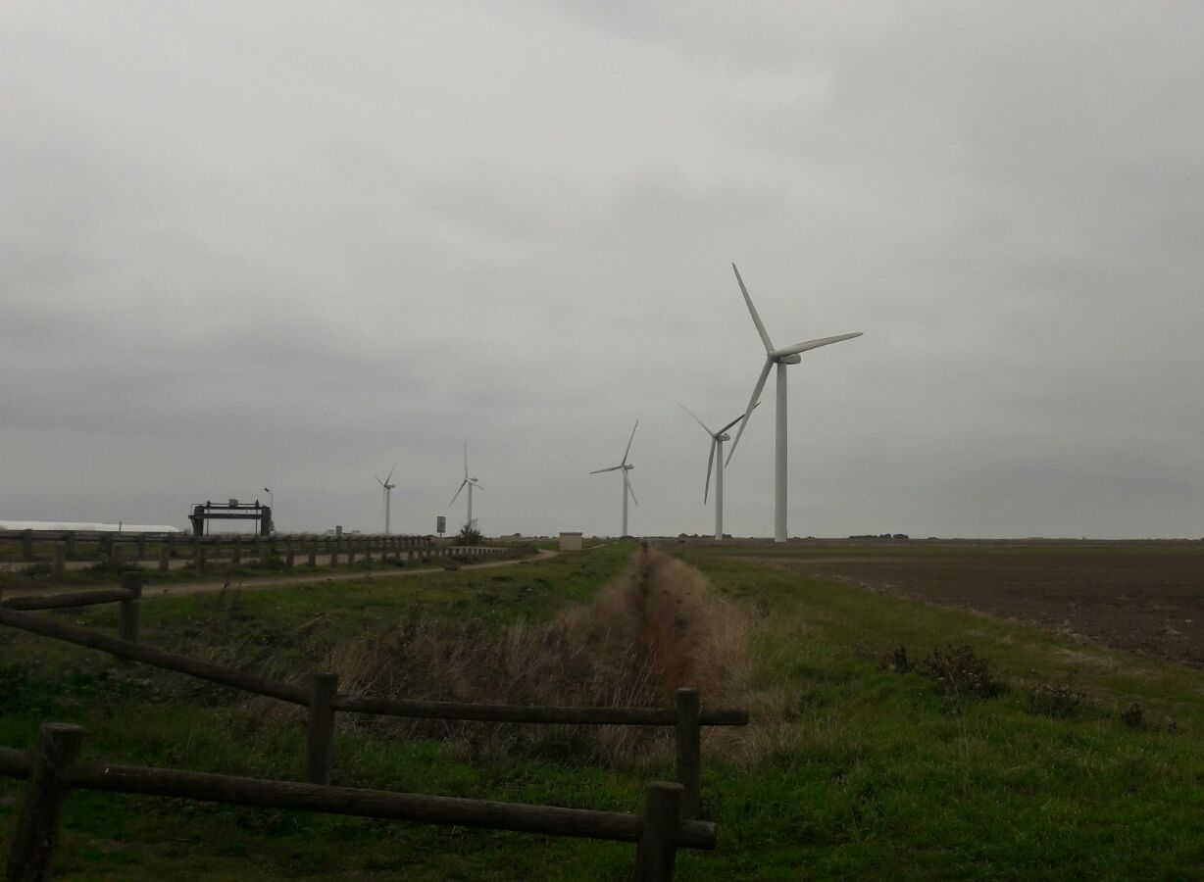




Wind Energy
ERASMUS +

Slide 2
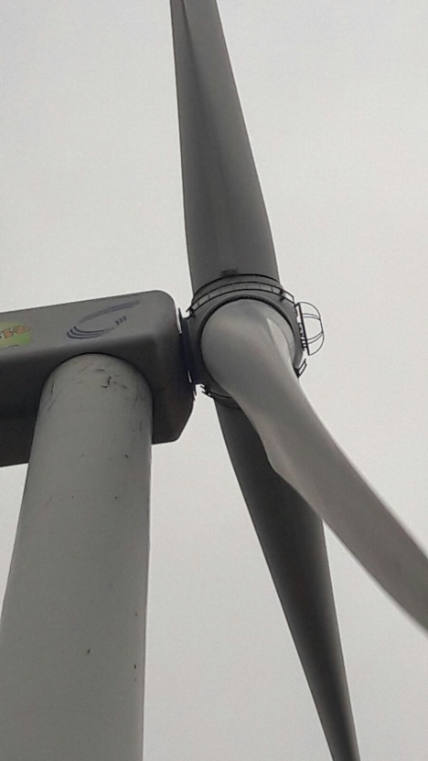
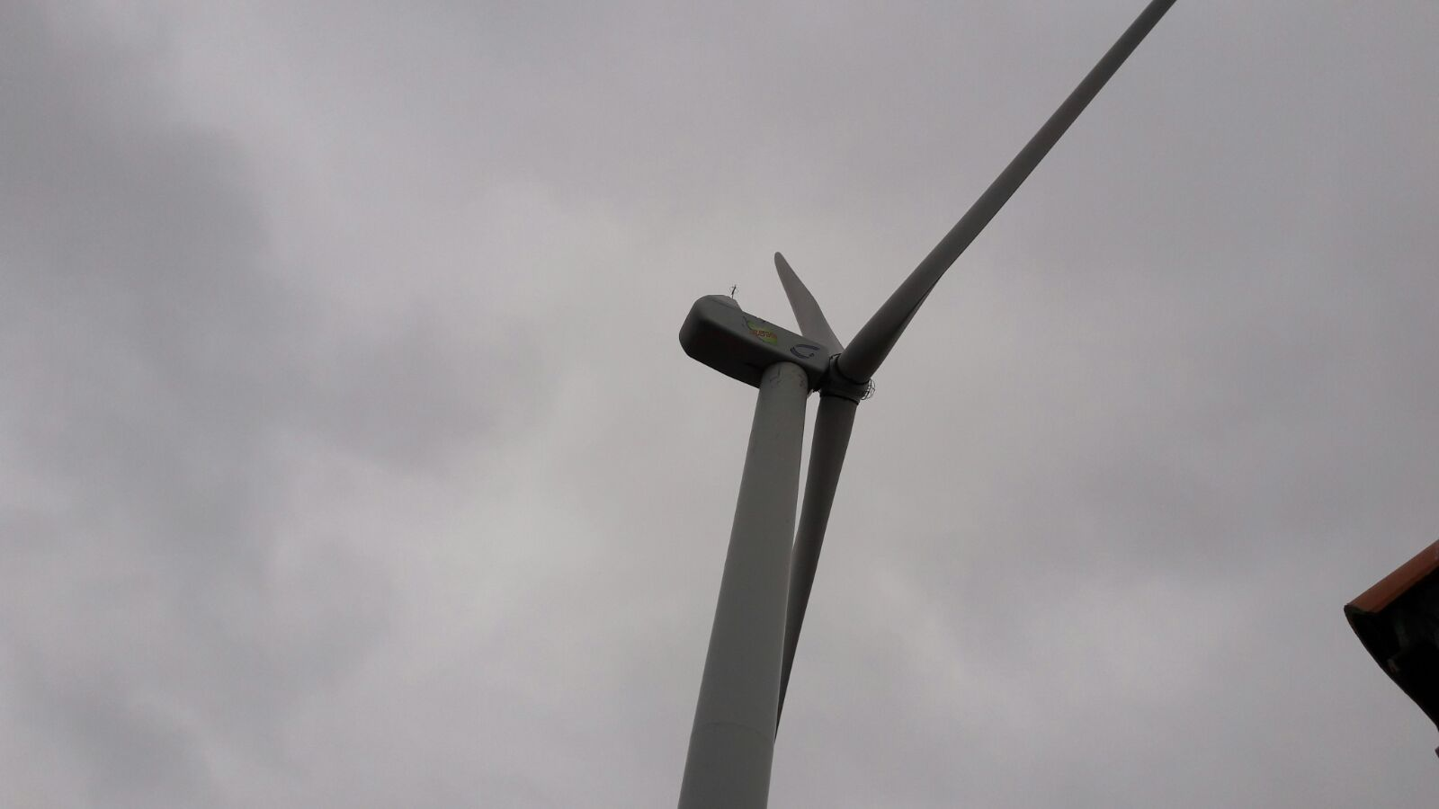
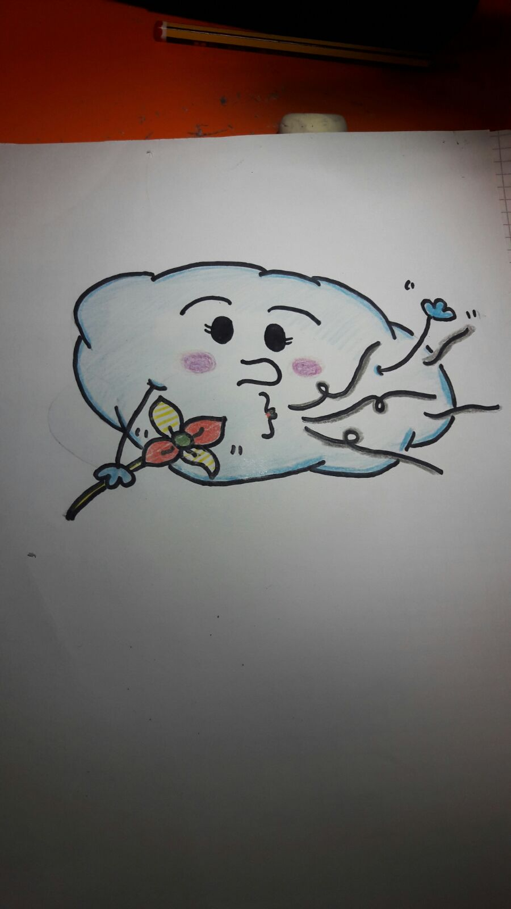
Hello I’m Mrs Cloudy
I am here to explain you wind energy

Slide 3
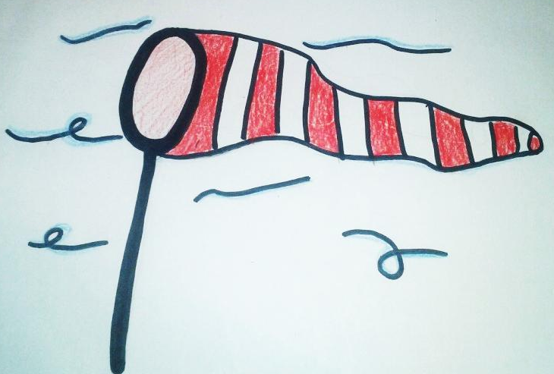
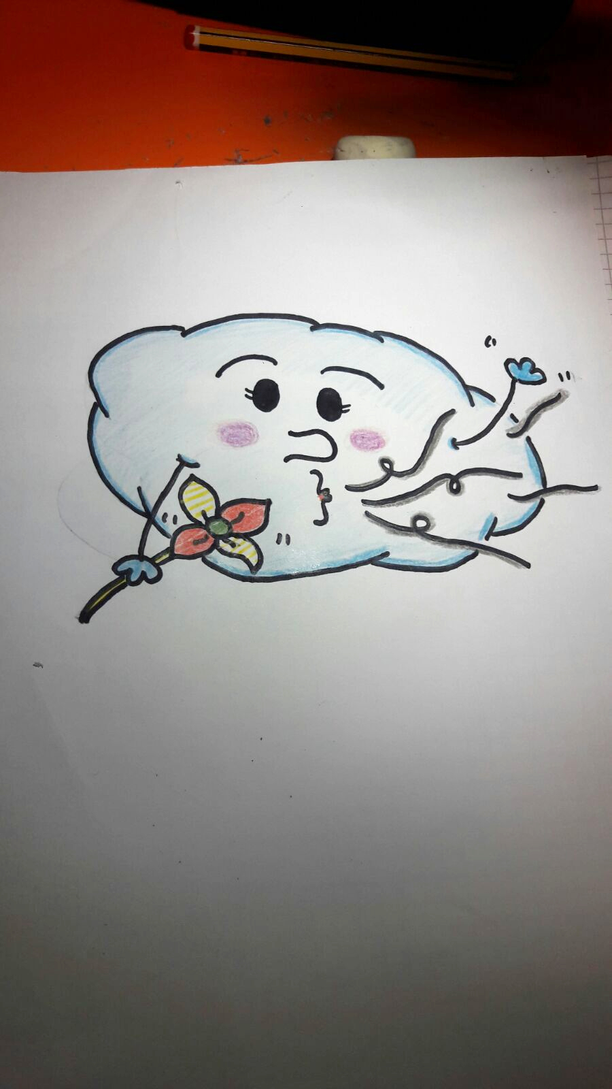
Do you know anything about wind energy?

Slide 4
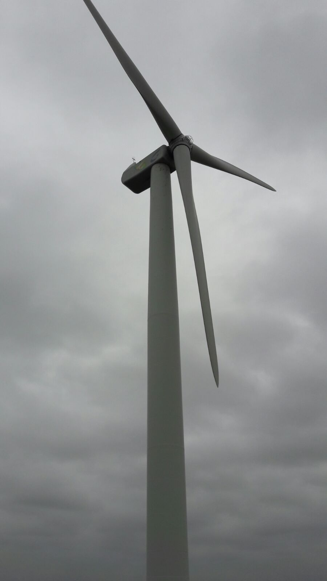
Wind mill parts
Nacelle
Impeller
Tower
Blade

Slide 5
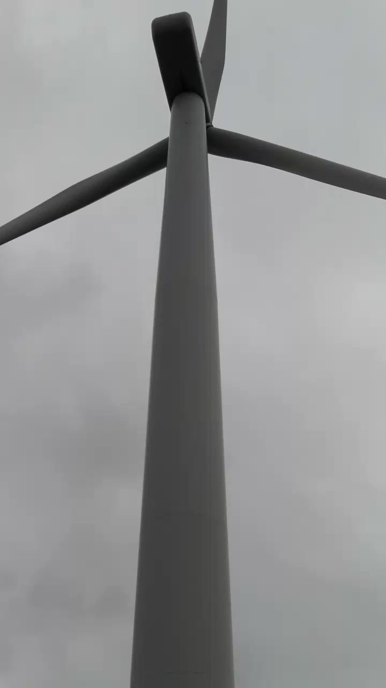
How does the wind mill work?

Slide 6

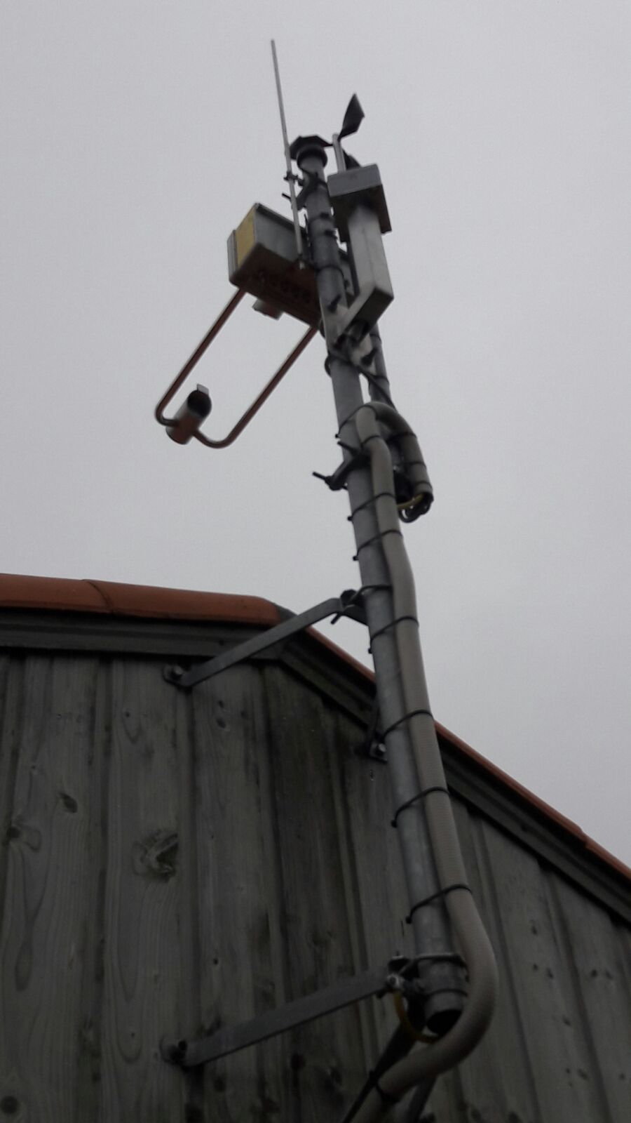
To make wind mill fuction you need …
The anemometer :
It detects the wind velocity. If it is between 12 and 90 km/h…
The turbine turns on and it moves the blades

Slide 7
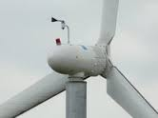
To make wind mill fuction you need …
The wind vane :
It detects the wind direction.
The turbine turns on and it moves the nacelle

Slide 8
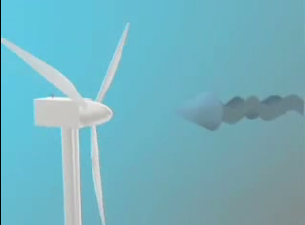
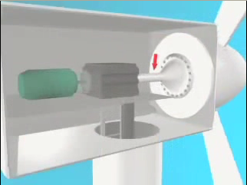
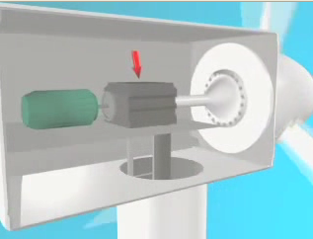
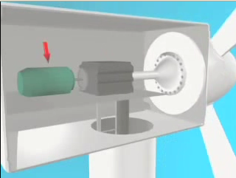
The multiplier transforms a small amount of energy into a huge one
The wind turns the blades
After that the axis causes the rotation of everything inside
And the generator transforms the energy into electricity

Slide 9
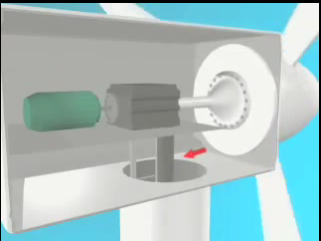
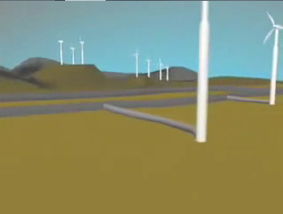
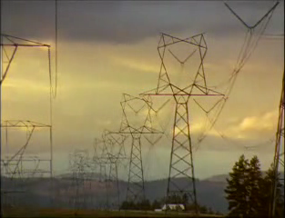
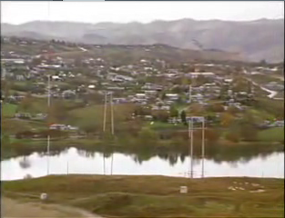
Then all this energy is used to empower cities , industries, houses, …
Through big cables
This energy is sent to a power station

Slide 10
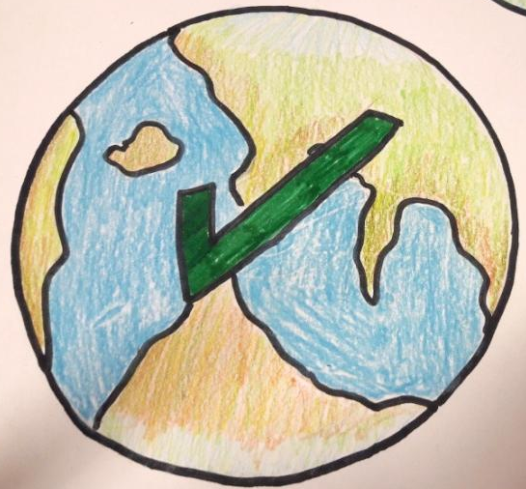
No pollution
Advantages
Lots of electricity
Economic
Plan for the future

Slide 11
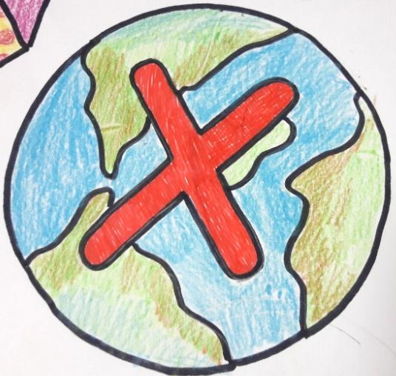
Noise
Bad for the birds
Disadvantages
Visual impact

Slide 12
THANK YOU!!!

Slide 13


made by: Henriette, Ángela, Berat, Marine

