Slide 1






Slide 2
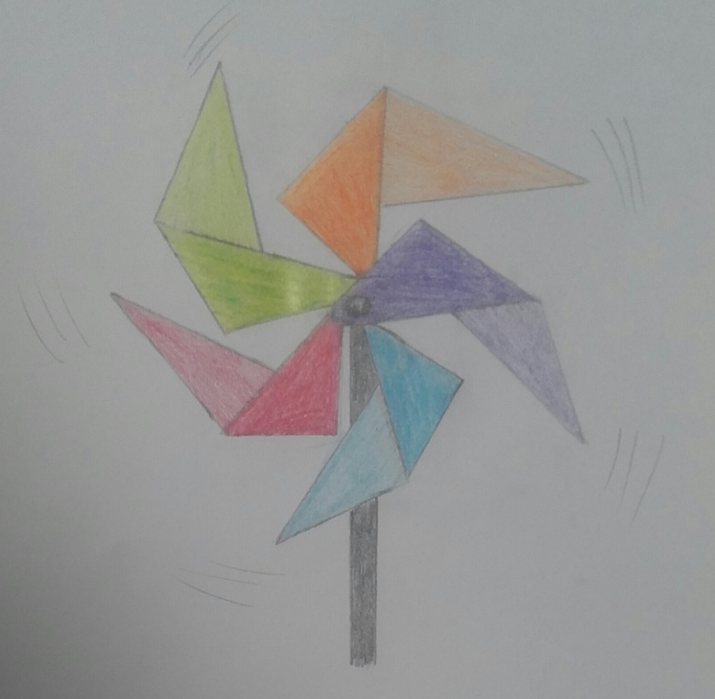
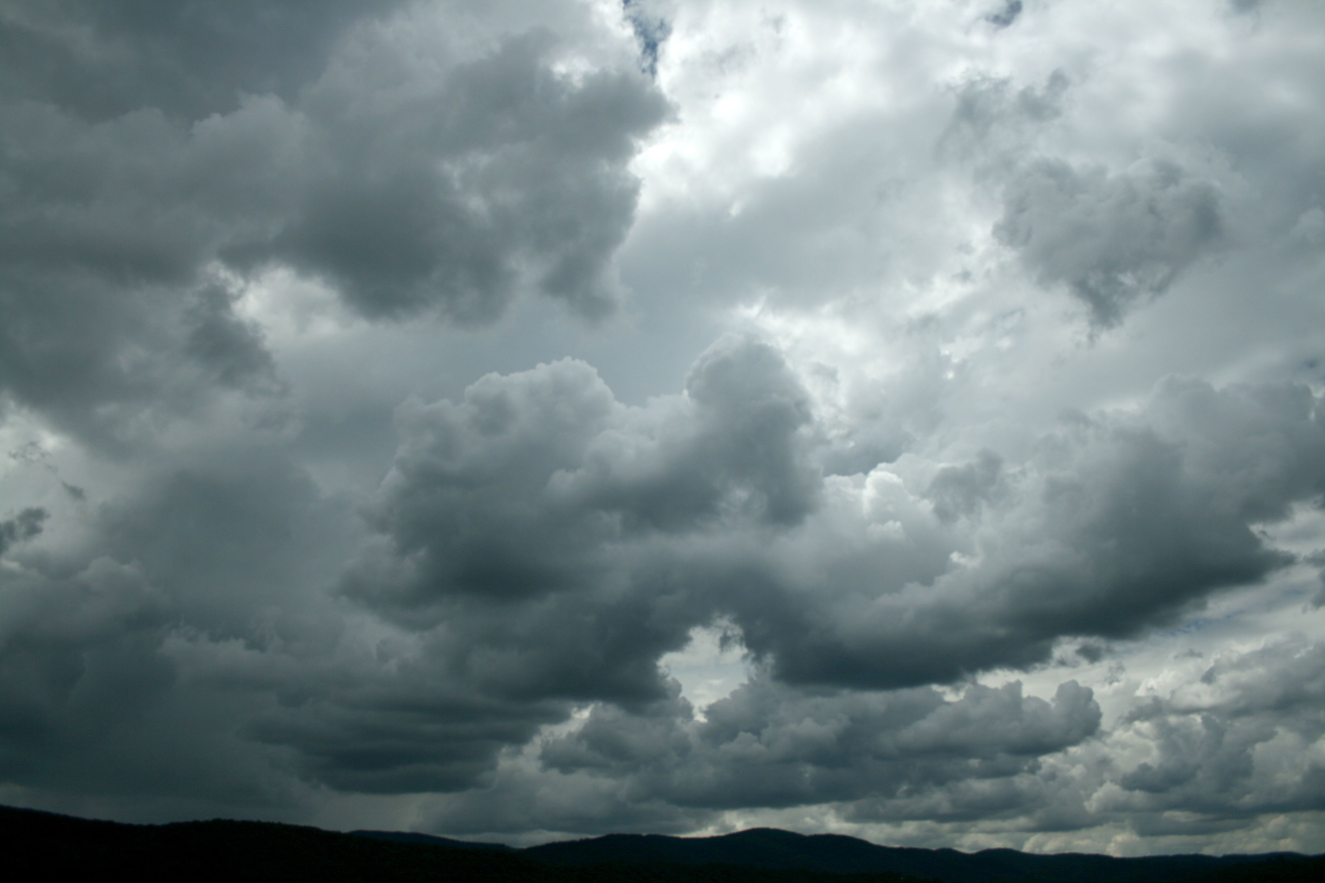
WIND, OUR ENERGY

Slide 3
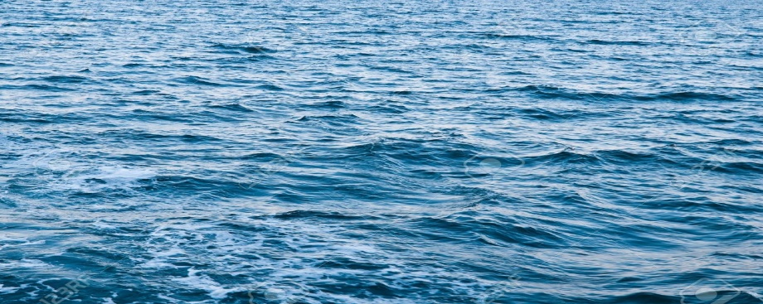

THERE ARE 2 TYPES OF MILLS:
MILL ON THE COAST
OFFSHORE MILL

Slide 4
HOW IT WORKS:
The wind makes the blades spin around
Then the blades move the turbine which produces renewable energy
The energy will be sent through the multiplicator
Blades
Multiplicator
Blades
Blades
Turbine

Slide 5

Then the generator transforms the energy into electricity
The energy will be sent to the power box on the ground
From there, it will be sent to OUR houses to set the lights on or other machines
Generator
Power box
Electricity

Slide 6
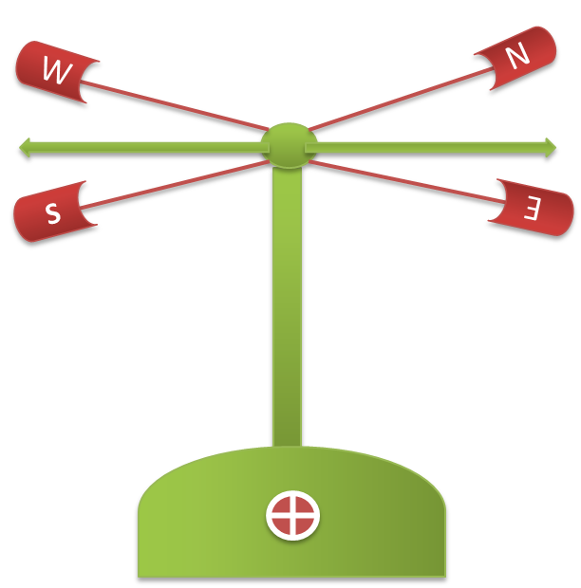
WEATHERCOCK:
The Weathercock detects and shows the direction of the wind, so that the Mill can set the direction in order to produce energy.

Slide 7
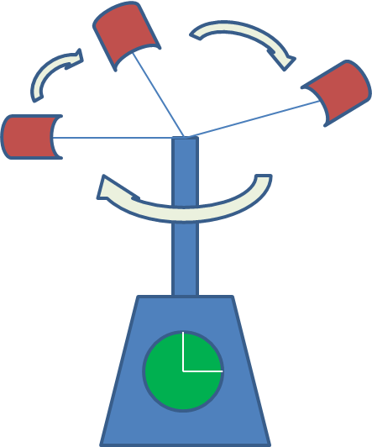
ANEMOMETER:
The Anemometer measures the speed of the wind, so the Mill can turn around being in the best position.

Slide 8

DANGER OF THE STRENGTH OF THE WIND:
When the wind is too fast, then the Mill cannot turn around because it can lose the blades or get too hot
If there isn’t enough wind the mill doesn’t produce energy

Slide 9
ADVANTAGES | DISADVANTAGES
It doesn’t pollute, it is ecological. | It changes the landscape.
It is good for the future of the planet. | It may affect specially birds ( mills on the coast ) and fish ( offshore mills ).
Wind is a never-ending source of energy. | The strength of the wind is not constant.
WHEN YOU GROW UP, THEN DECIDE IF YOU WANT TO SAVE OUR PLANET THANKS TO WIND ENERGY !

Slide 10
GOODBYE
THANKS YOU FOR YOUR ATTENTION

