Slide 1






Slide 2
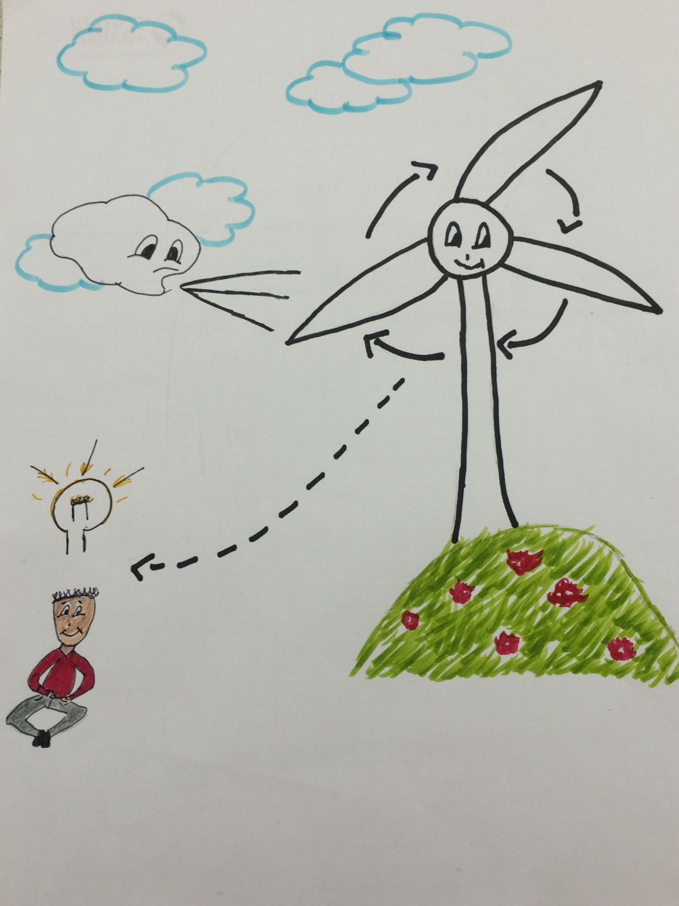
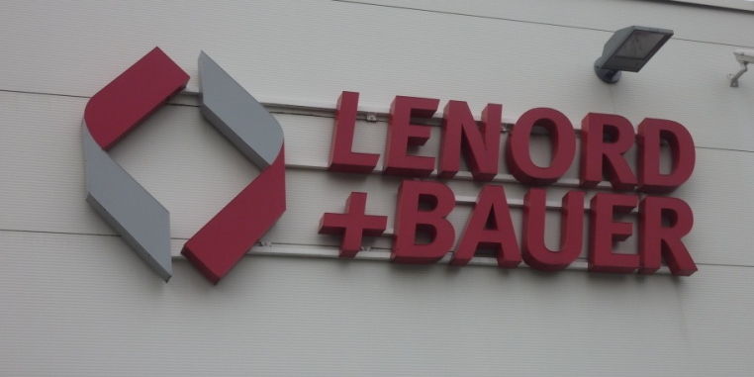
Wind power

Slide 3
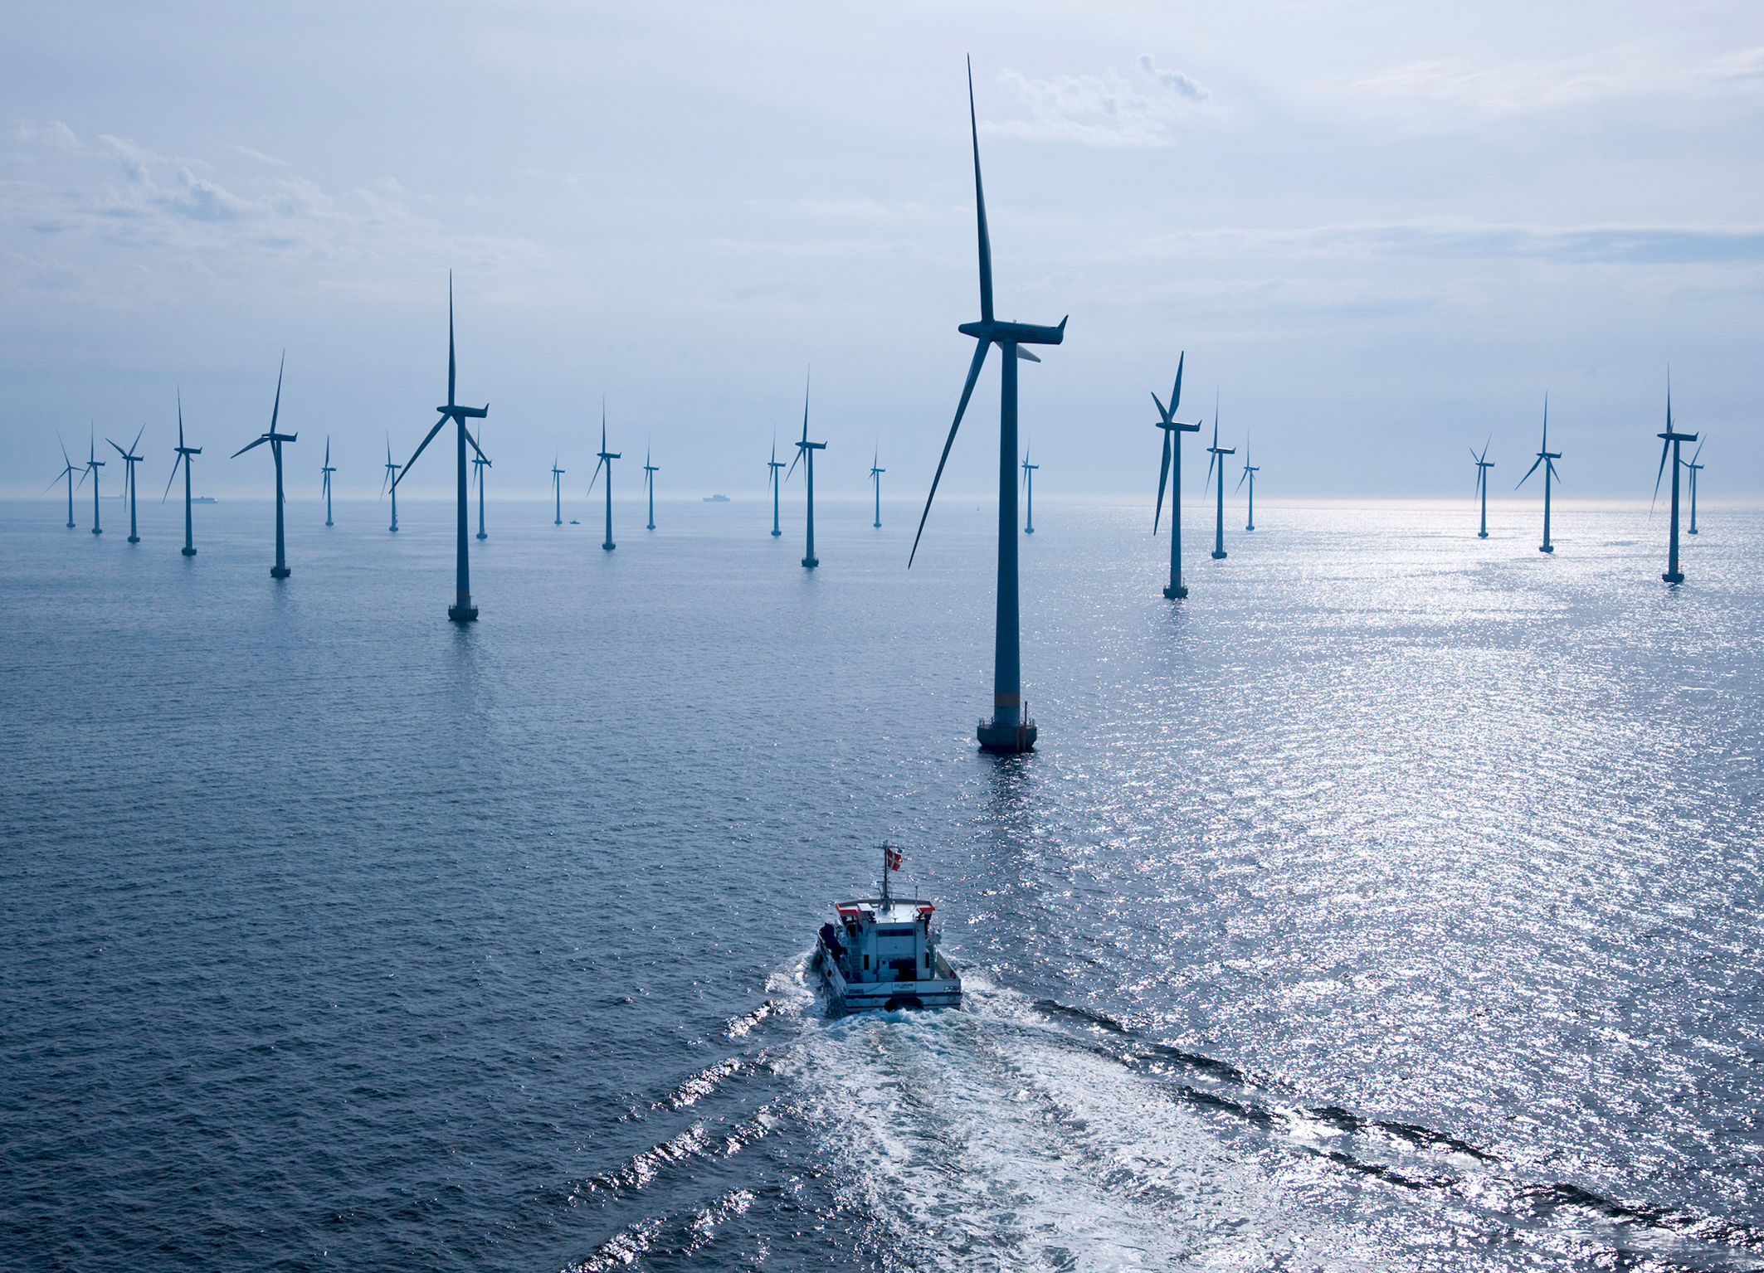
Index
-Renewable energy
-fossile/renewable energy
-pros and cons renewable energy
-Windenergy
How?
Where? Why?
-Lenord and Bauer
parts in windturbines
-Summary

Slide 4
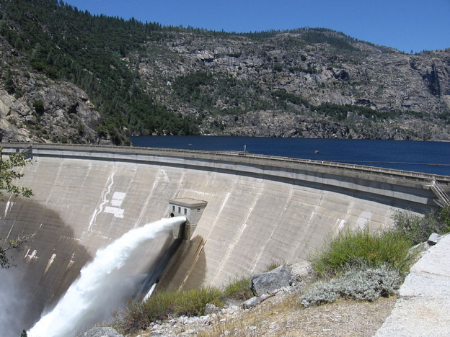
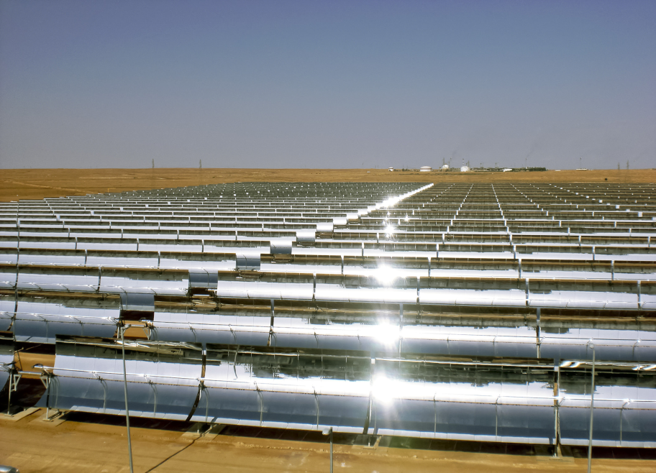
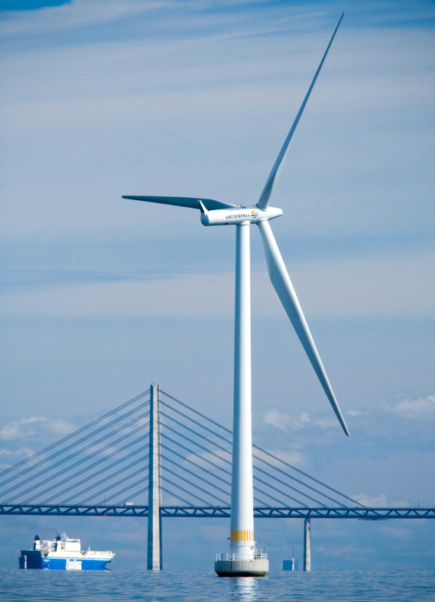
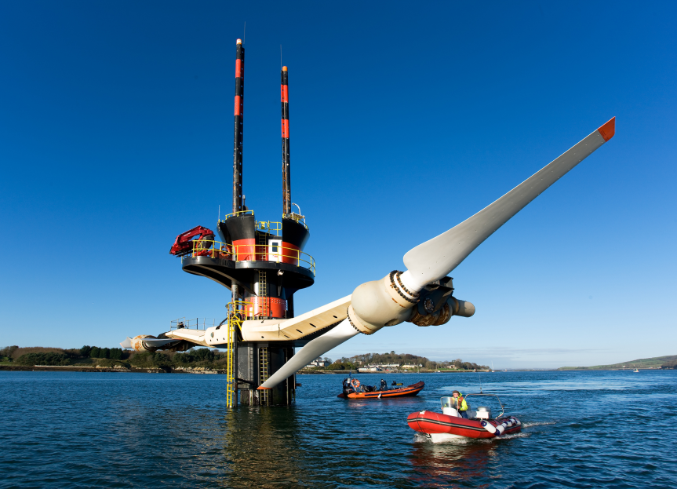
Renewable energy
Energy with renewable ressources
-solar energy
-wind energy
-water energy
-geothermal energy
Good for the environment
Renewable energy at home
Energy of the future

Slide 5
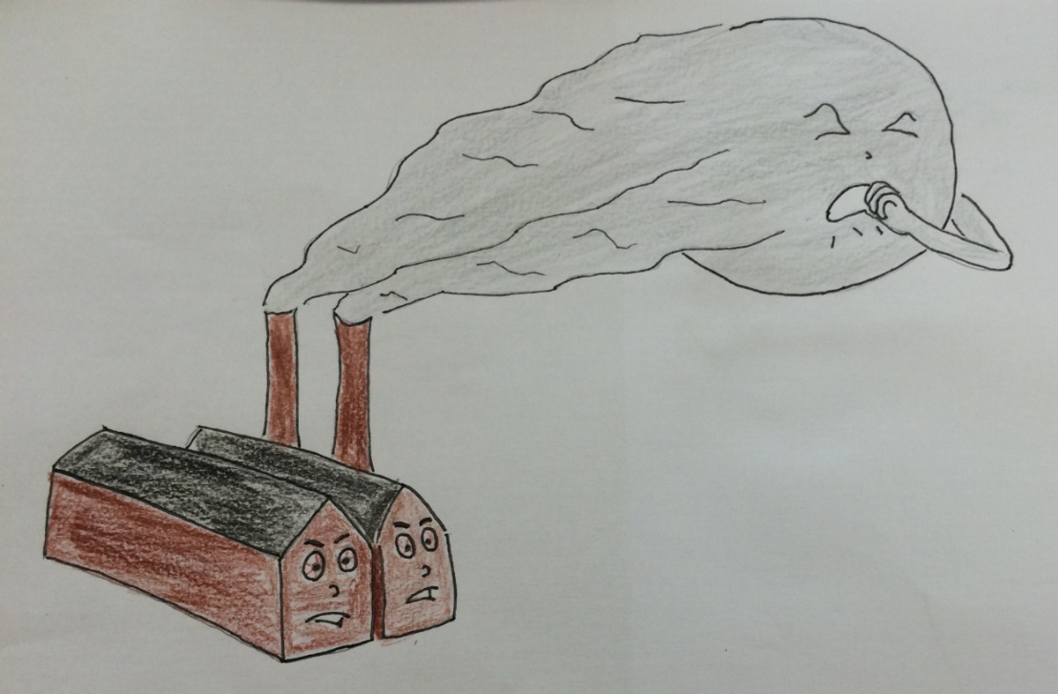
Fossile-/Renewableenergy
Oil/Charcoal/Gas is needed | Sun/water/wind is forever
Bad for the nature/creature | Not so bad for the nature
Not for ever available | For ever available
Not so expensive | Expensive to build

Slide 6
Pros&Cons
Of renewable energies
PROS
Infinite
No costs for burningmaterial (beside of bio-gas)
Constant prices
Safe envirorment
CONS
Changing of landscape
High prime costs
Loud/annoying

Slide 7
How do windtourbines work?
-The wind is blowing
-The windtourbine is turning
-The generator produces electricity
-The electricity is sent to you

Slide 8
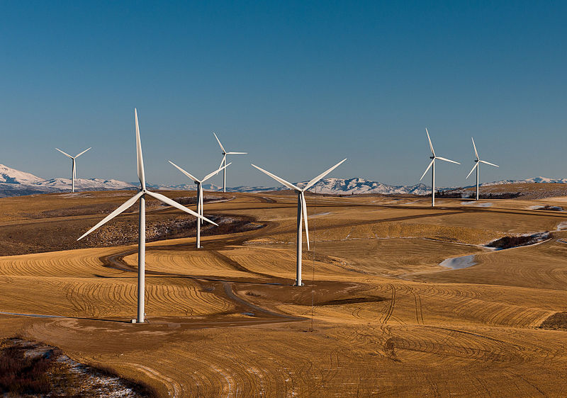
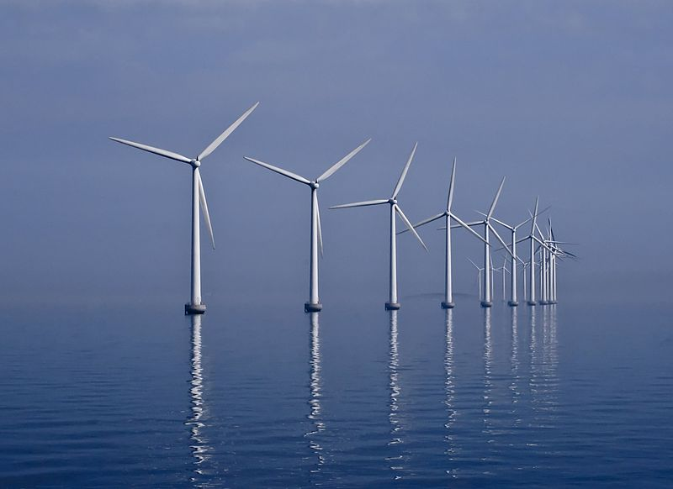
Where and why??
Offshore at the sea
On fields
They need space
On the sea it is always windy

Slide 9

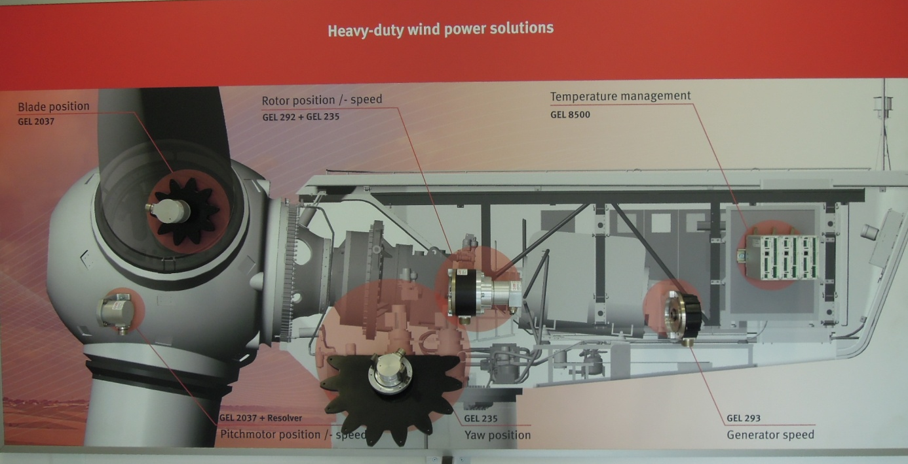
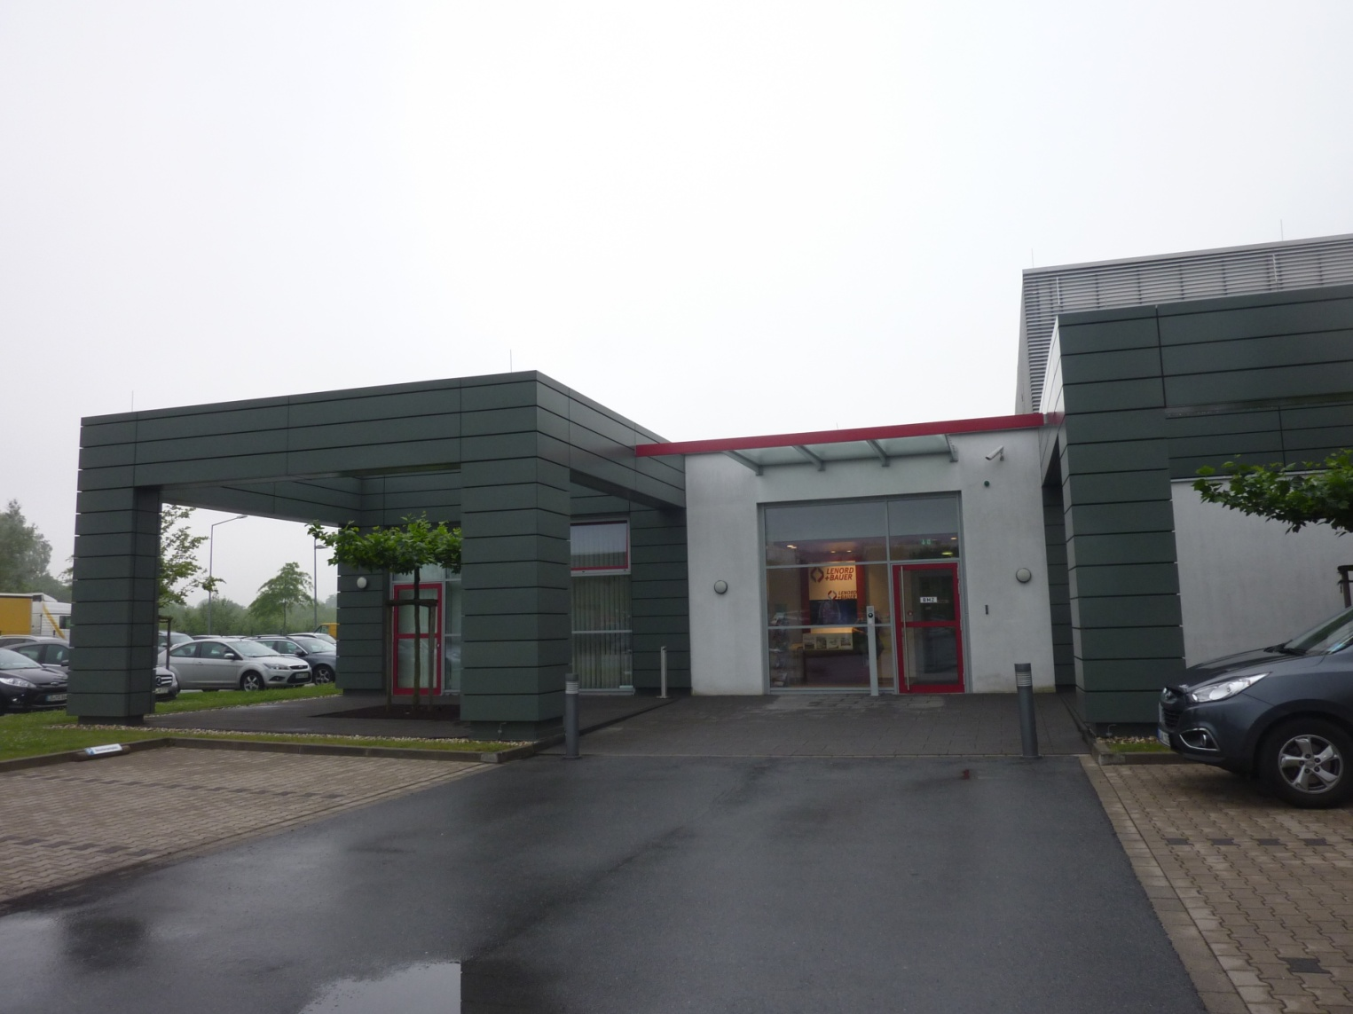
Lenord&Bauer
Important parts for windturbines
L&B produces parts for windturbines and trains
L&B are producing sensors and controllsystems for windturbines
That means best safety and most efficient way to produce electricity
So that the windtourbine gets
-the right position
-the right speed
-the perfect temperature

Slide 10
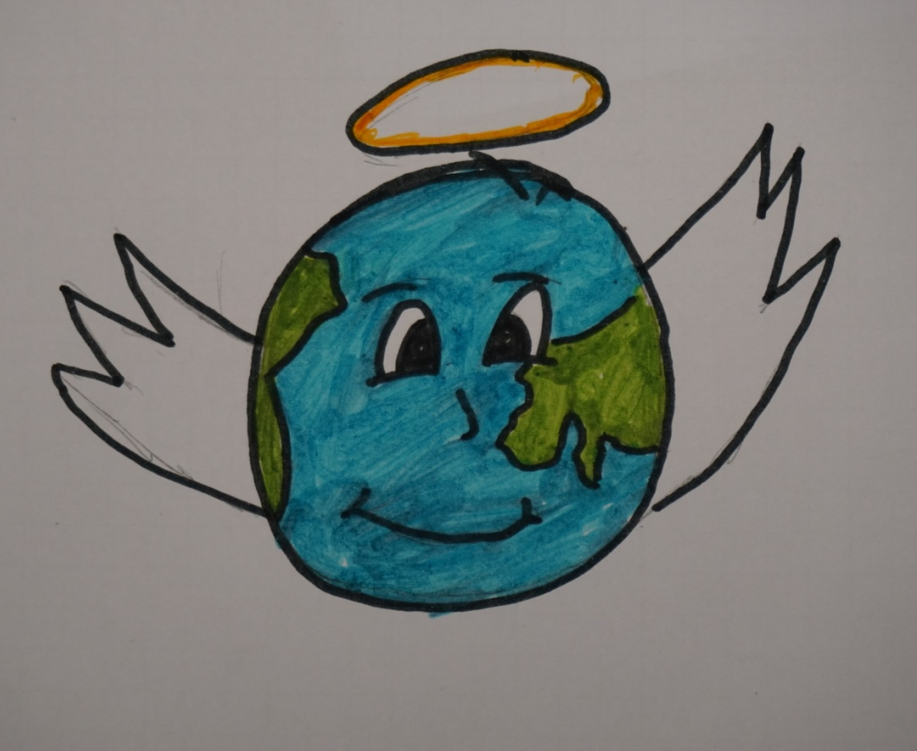
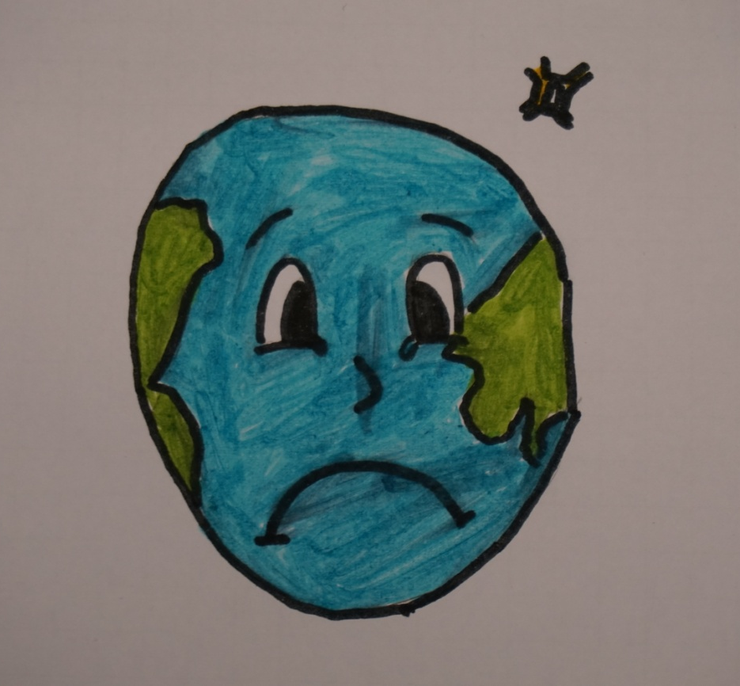
Summary
Fossil energies will distroy our earth!!!
We need renewable energies to protect our lives!!!
For that we have to inovate our technology
Like Lenord & Bauer does.

Slide 11
Sources
-www.siemens.com/presse
-www.wikipedia.org
-Lenord, Bauer und CO.

Slide 12
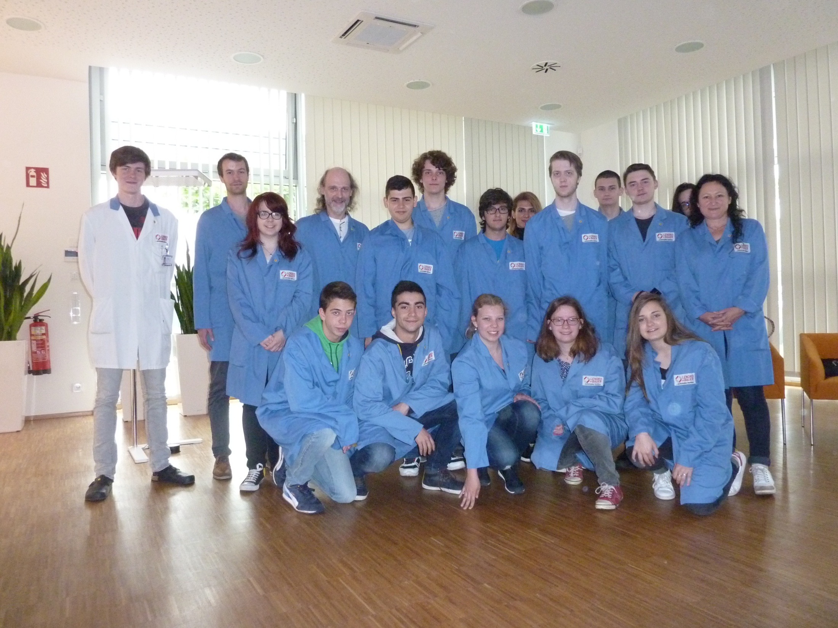
Thanks for watching ☺
THE END

