Slide 1



MARINE RENEWABLE ENERGY

Slide 2
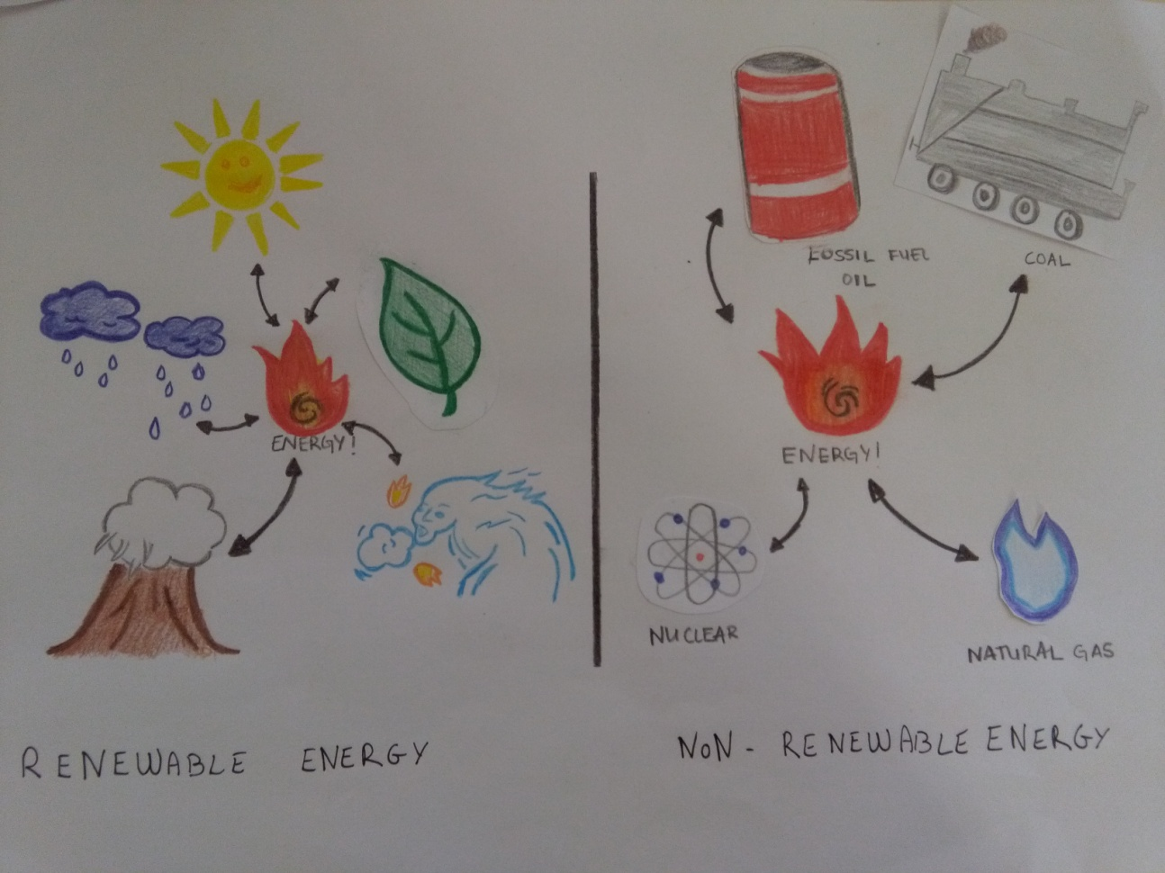
What is renewable energy?
Generally defined as energy that is collected from resources which are naturall. Energies will don’t run out.

Slide 3
TIDAL ENERGY
The period of the tidal waves is about 12 hours during the day: the water rises and falls two times.

Slide 4
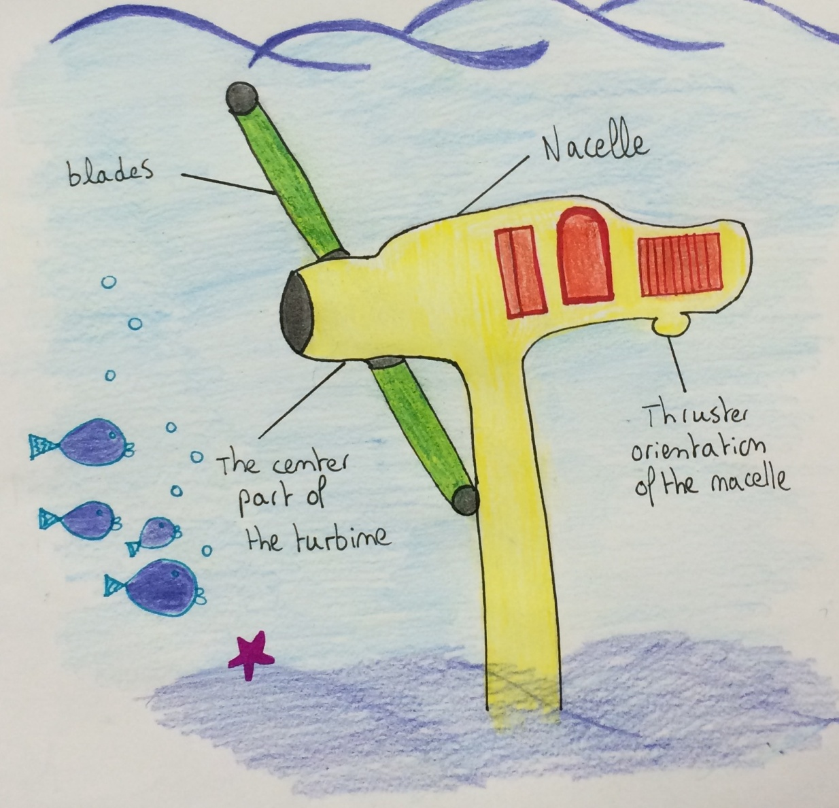
THE TURBINE

Slide 5
ADVANTAGES
DISADVANTAGES
  Friendly environment
  Don’t produce gases
  Predictable
  Don’t need fuel
Kills animals under water
Not very effective
Expensive
Only happend twice a day, the energy has been produce at these time

Slide 6
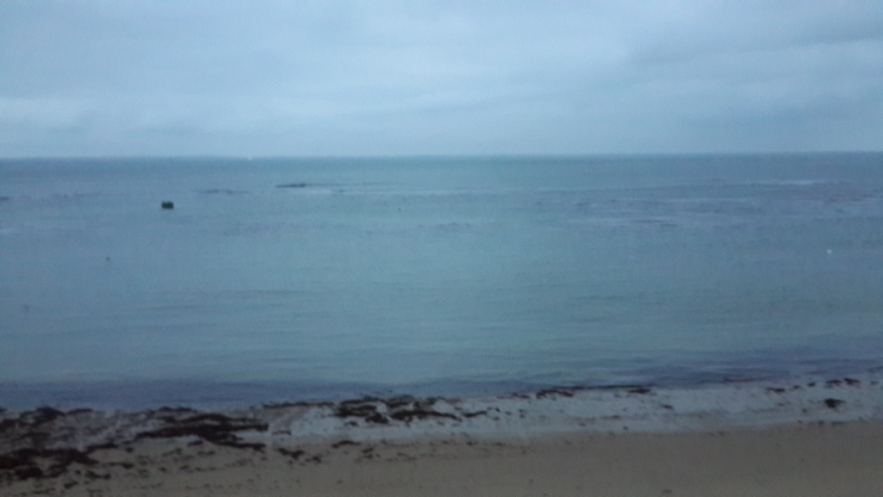
WAVE ENERGY
It’s the energy which produces electricity from sea waves.
If you want to produce wave energy; you need seas or oceans where the water isn’t too calm.

Slide 7
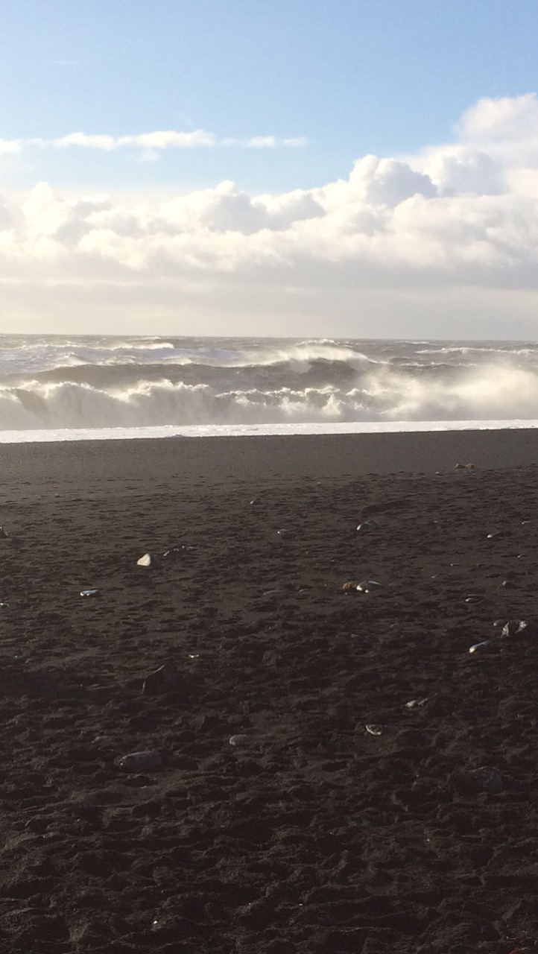
Energy is produced by the wave power. It is not very common because the wind damages to tribunes. Your need huge currents in water to get enough energy.

Slide 8
ADVANTAGES
DISADVANTAGES
  Environment friendly
  Easily predictable
  No damage to land
Can’t use everywhere
Bad effect on the marine ecosystem
Noise and visual pollution

Slide 9
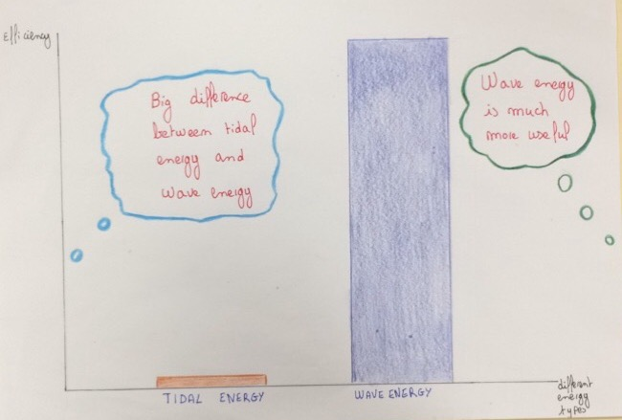
WAVE ENERGY | TIDAL ENERGY

