Slide 1
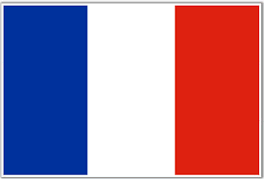


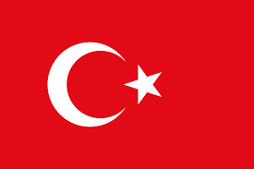


Slide 2
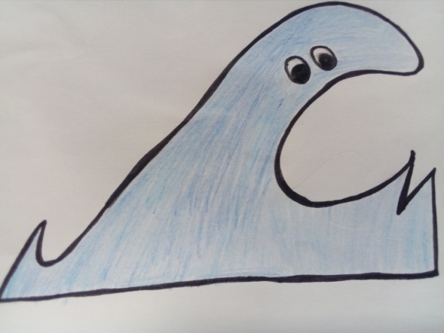
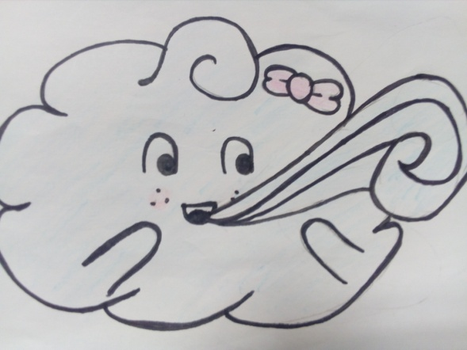
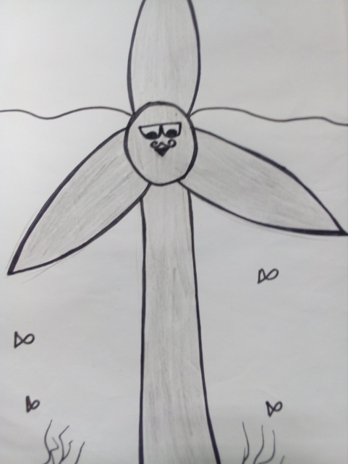
Marine renewable energies
Hello my name is Windy I represent the wind.
Wind turbines
waves
Tidal
¡Hola! I’m wave
Bonjour i’m monsieur Tidal

Slide 3
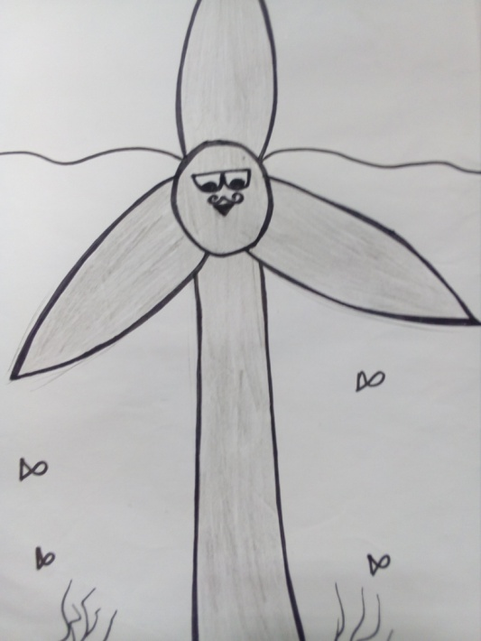
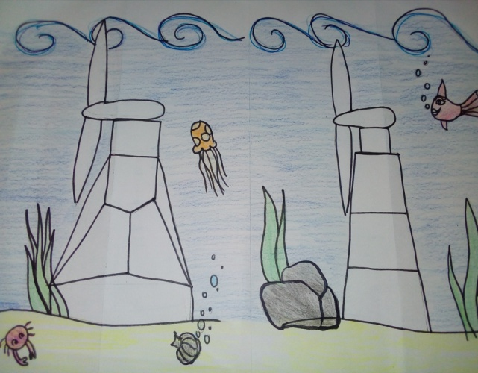
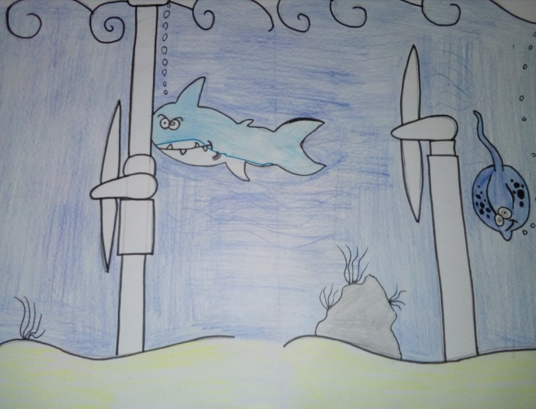
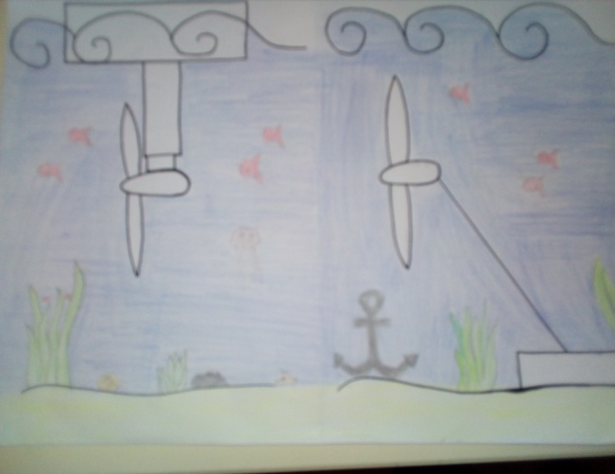
Tidal energies
What is it ?
It’s the energy contained in the tides which creates water currents.
These movements are due to the combined actions of the moon and the sun on the earth.
Turbines are placed in these currents in order to extract part of the energy to produce electricity.
I live and work in the water
The different types of tidal turbine

Slide 4
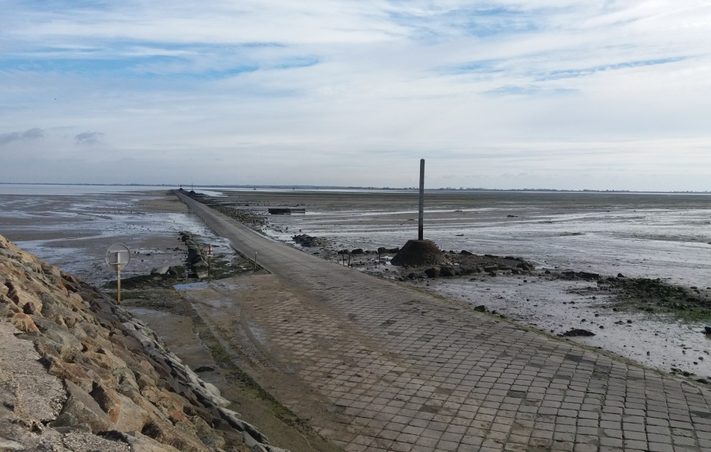
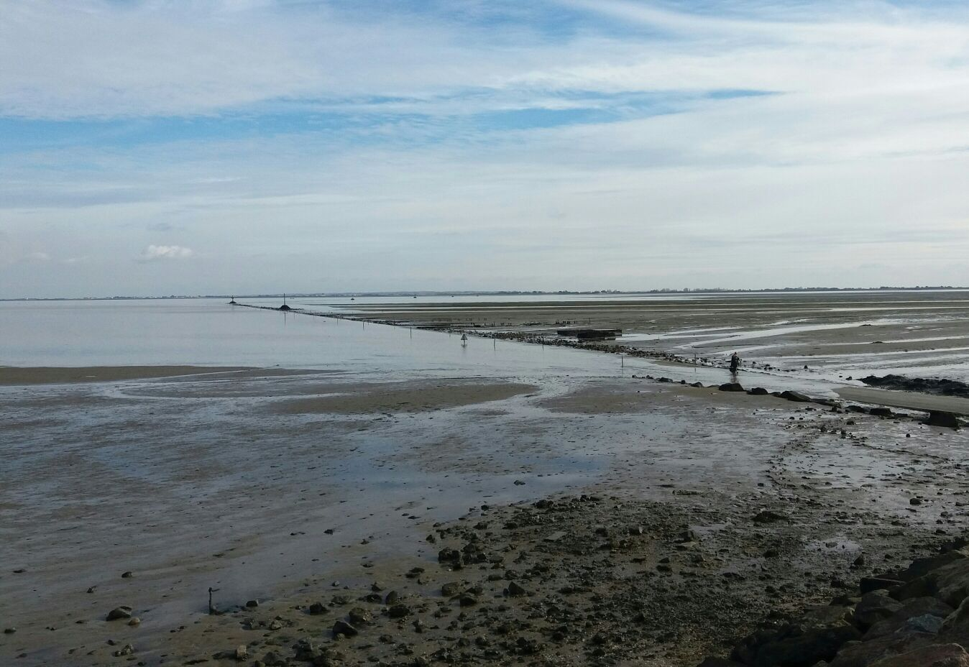
The movement of the ocean
This is the low tide, the water goes down because of the influences of the moon and the sun.
Now you can see the road in the middle of the water.
This is the high tide.
We can’t see the road , we only see the water.

Slide 5

Advantages of the tidal resource
These are my advantages
Predictable tidal currents can be predicted a very long time in advance
Visual « pollution » reduced (sub-marine structure)
Reduced size compared to an equivalent wind turbine.

Slide 6
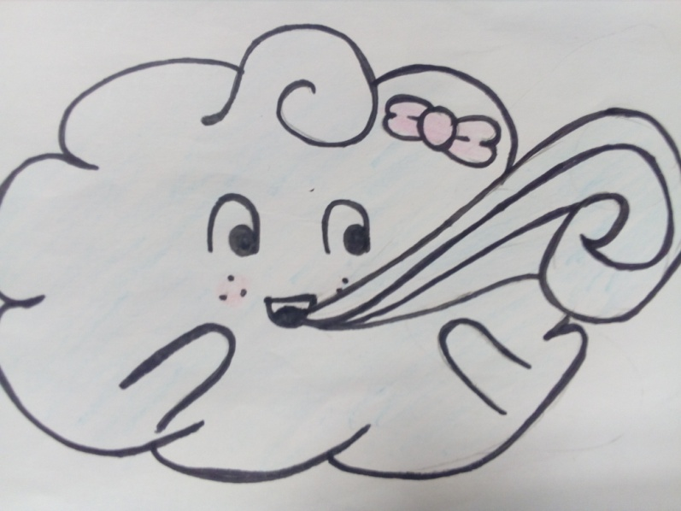
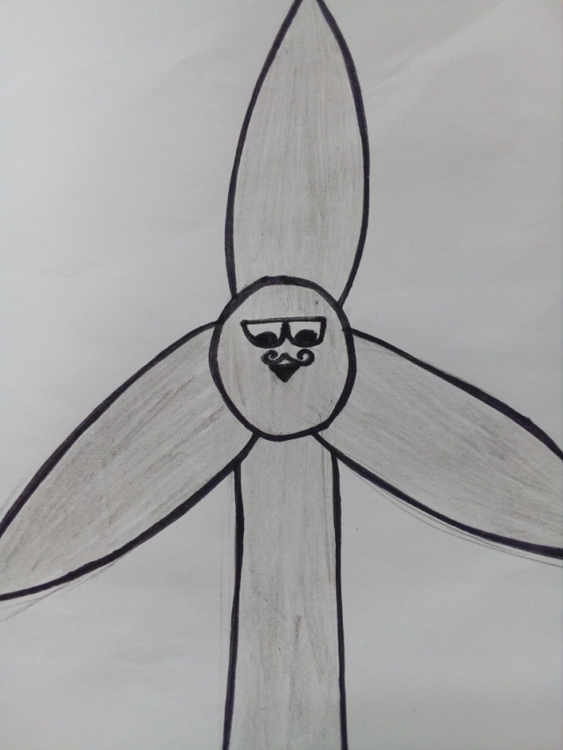
Offshore wind energy
What is it?
I live in the sky and my job is blowing wind to the wind turbine.
It is a set of devices which convert the strength of winds in mechanical energy which is
Then transformed into electrical energy.

Slide 7
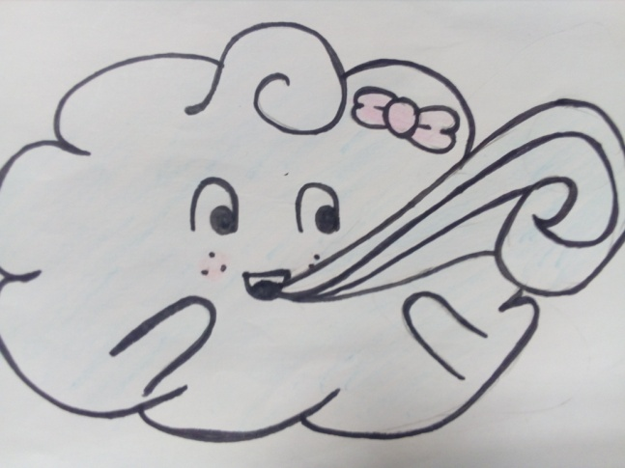
Advantages of the wind energy
These are my advantages
The wind is free.
Wind energy is friendly to the environment, as no fossil fuels are burnt to generate electricity from wind energy.
Wind turbines take up less space than the average power station.
Newer technologies are making the extraction of wind energy much more efficient.
Wind turbines are a great resource to generate energy in remote locations, such as mountain communitiesand remote countryside.
When combined with solar electricity, this energy source is great for developed and developing countries to provide a steady, reliable supply of electricity.

Slide 8

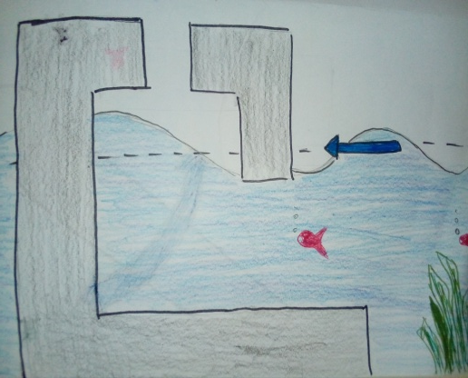
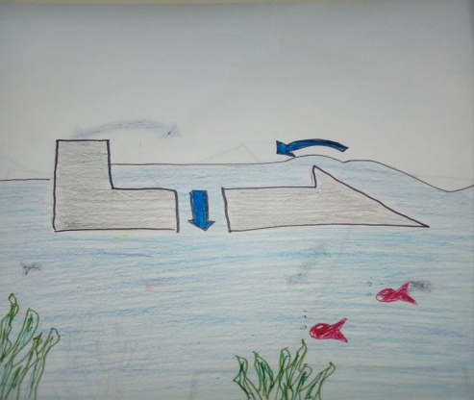
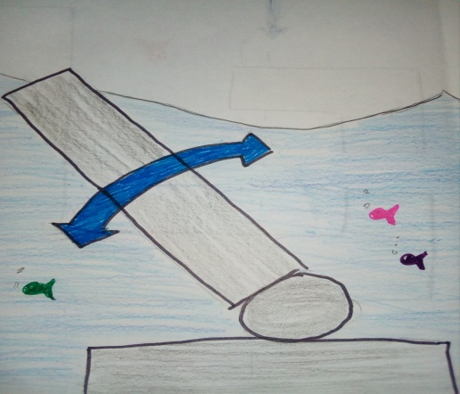
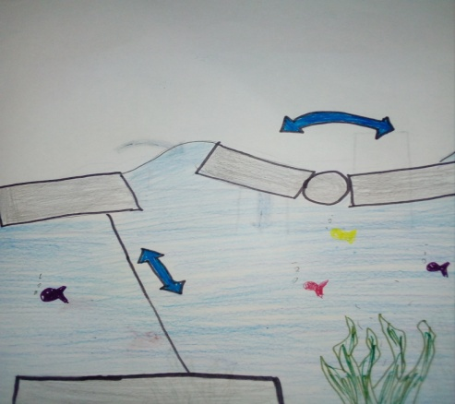
Wave energy
With my power I produce energy
The different typs to produce energy
What is it?
Wave power refers to the useful work created from the waves. Waves are generated by the wind passing over the surface of the sea. Then the can propagate in the ocean over very large distances.

Slide 9

Advantages of wave energy
¡Hola! I produce the best energy!
Wave energy is friendly to the environment and it is renewable
The wave energy is consistent (never run out)
wave power does not cause any damage to earth
It is safe, clean and one of the preferred method to extract energy from ocean
lots of people can get use from wave energy plants

Slide 10
Electrical market
42,6% Nuclear energy
30,1% Oil
14,0% Gas
9,5% Renewable energy
3,4% Coal

Slide 11
Advantage/Disadvantage
Advantages:
-creates jobs
-increased energy mix
-innovation sector
-impact of energy cost
-big potential
Disadvantages:
-collisions (a boat can hit a turbine)
-noises and vibrations
-chemical pollution
-submarine pollution
-destroy fauna

Slide 12
Thank you
Merci
Danke
Teṣekkürler
Gracias for your attention
Made by Audrey, Canem, Clement, Lara

