Slide 1






Slide 2
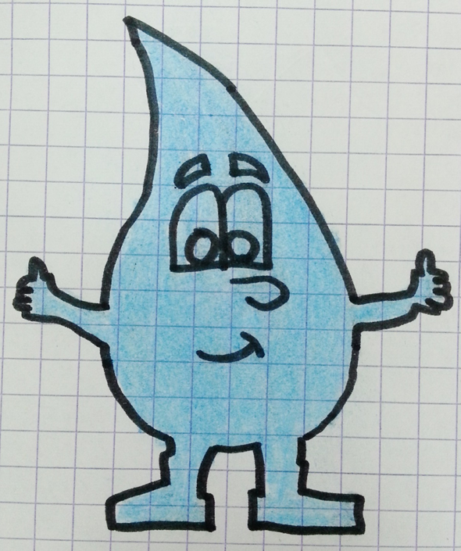
Geothermal Energy
My name is Dropy

Slide 3
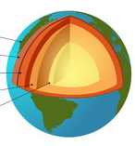
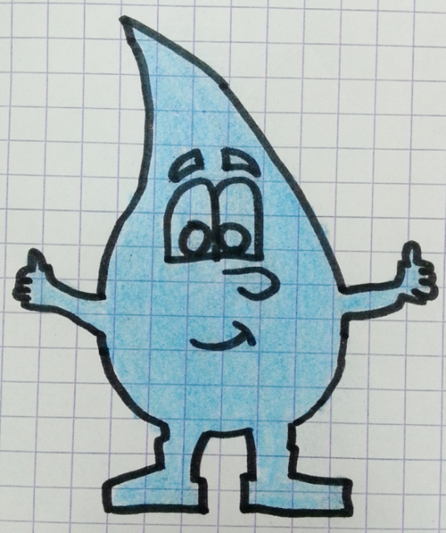
DO YOU KNOW WHAT GEOTHERMAL ENERGY IS?
It is electricity produced by heat which comes from the inside of our earth

Slide 4
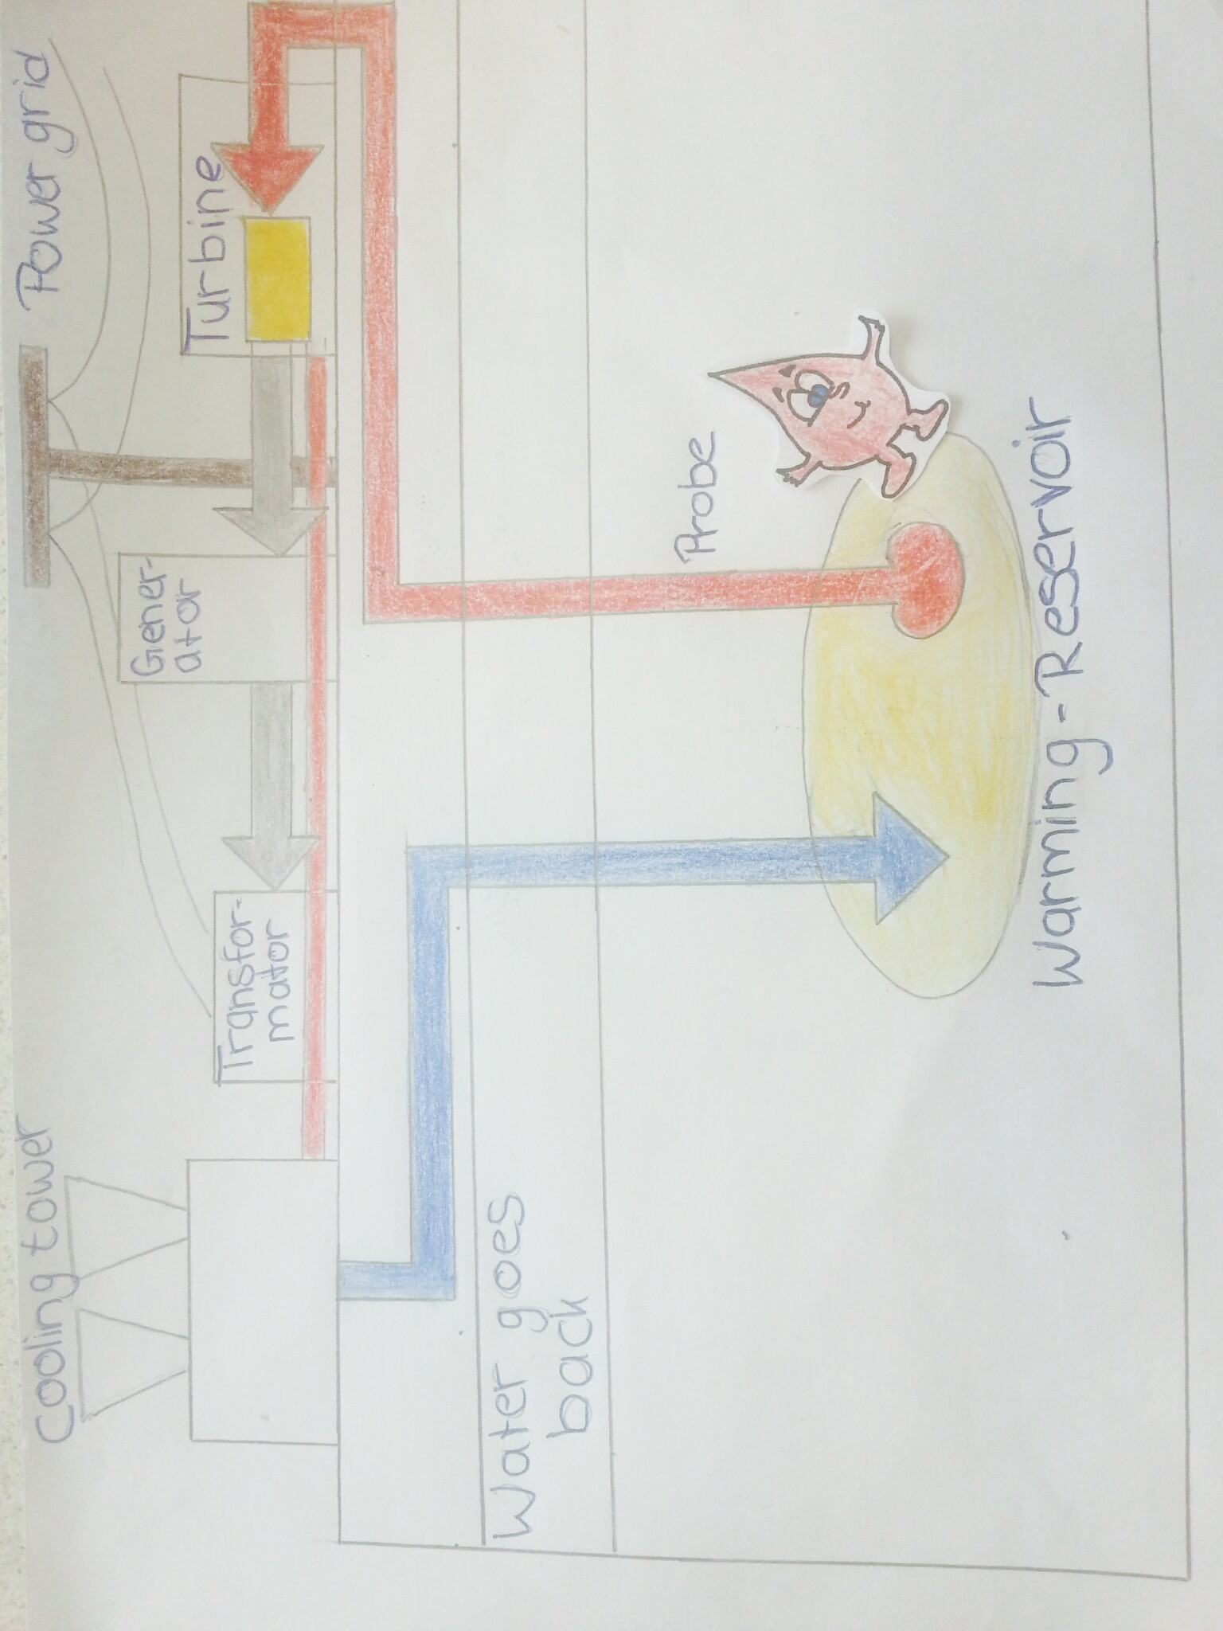
How it works:
I´m a hot waterdrop

Slide 5
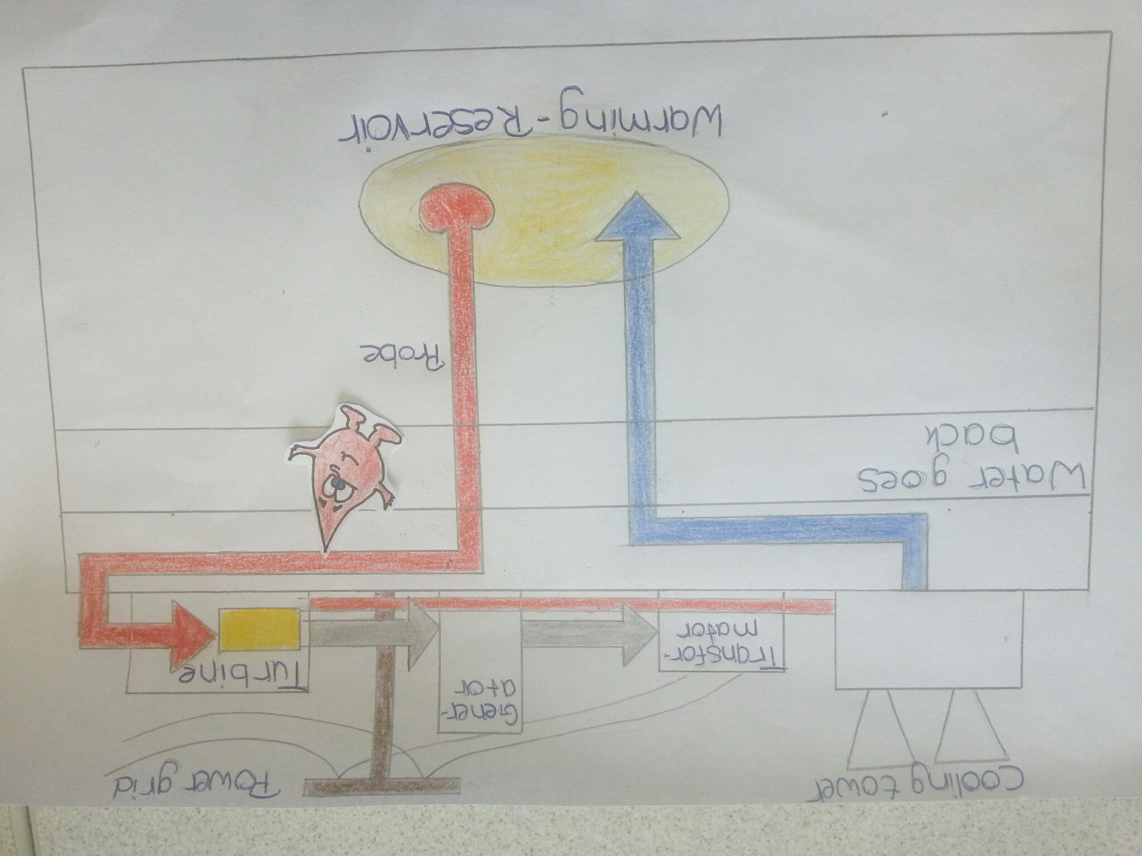
Now I am going to the Turbine

Slide 6
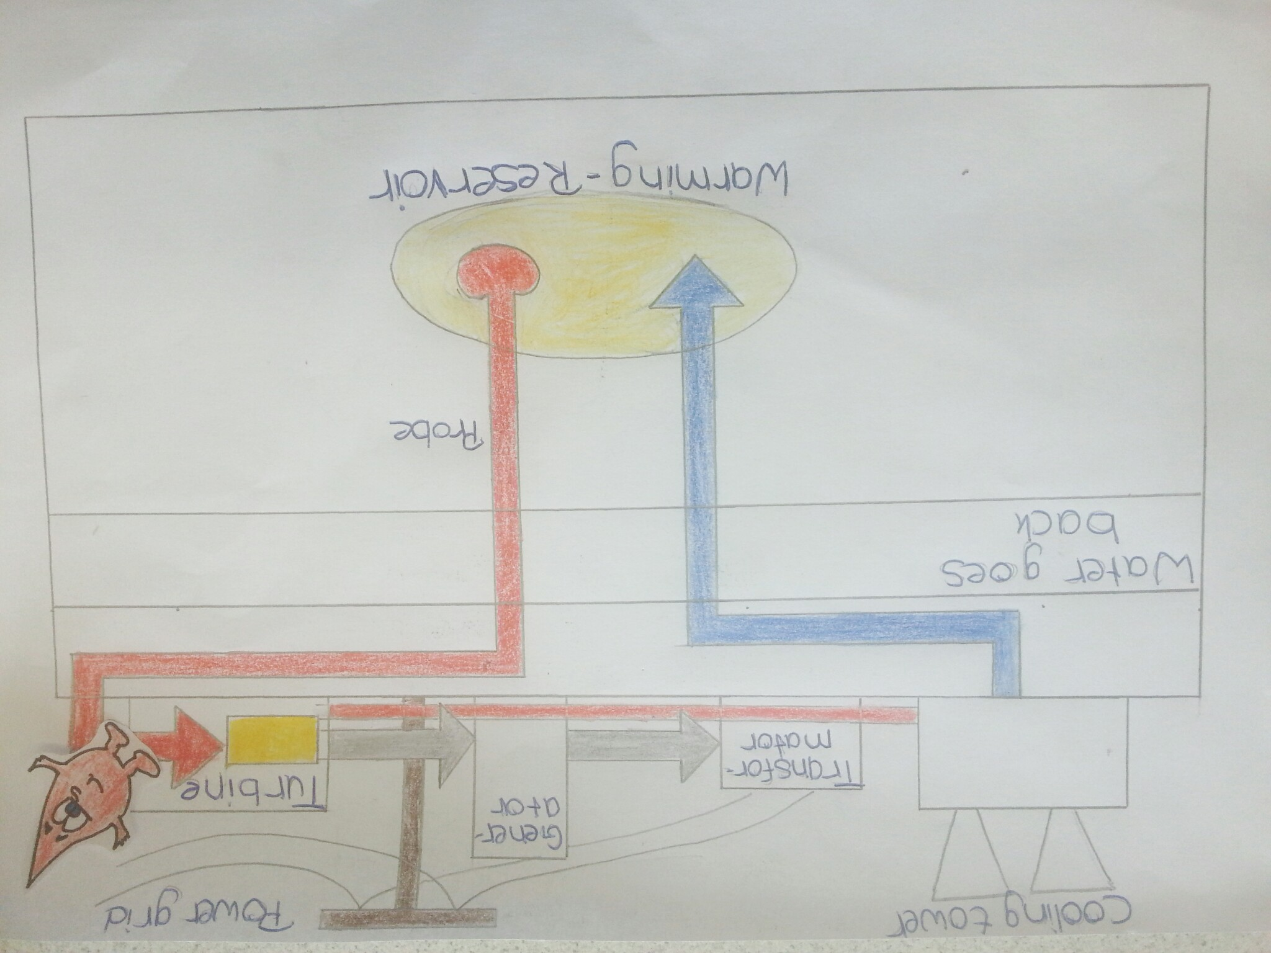
In this step the Turbine produces energy and boost the Generator with it

Slide 7
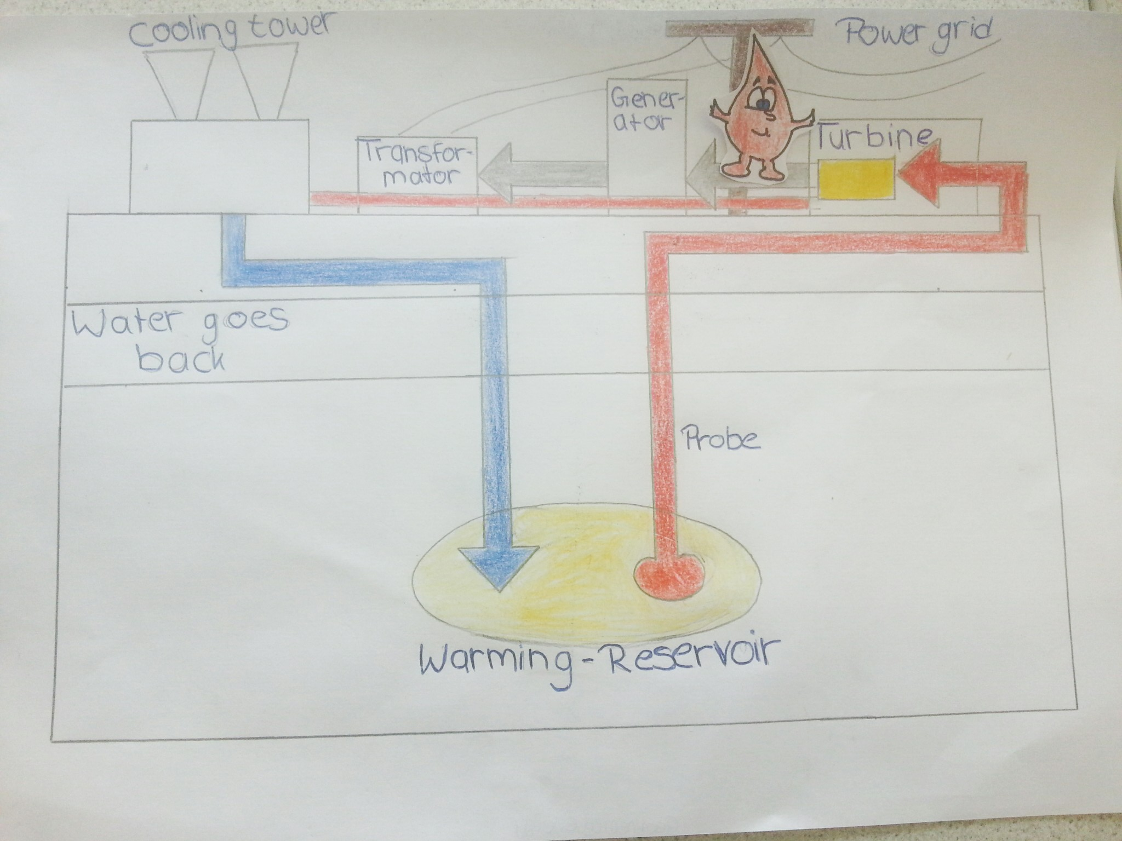
The Generator produces the electricity

Slide 8
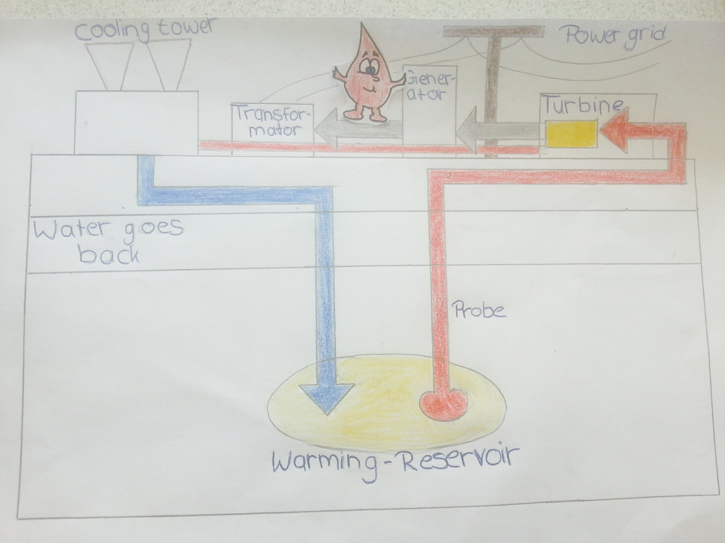
Here the electricity goes from the Generator to the Transformator

Slide 9
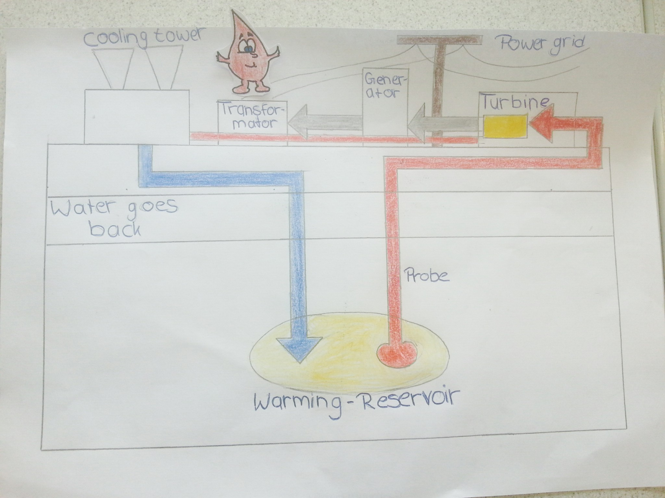
The Transformator brings the electricity to your House

Slide 10
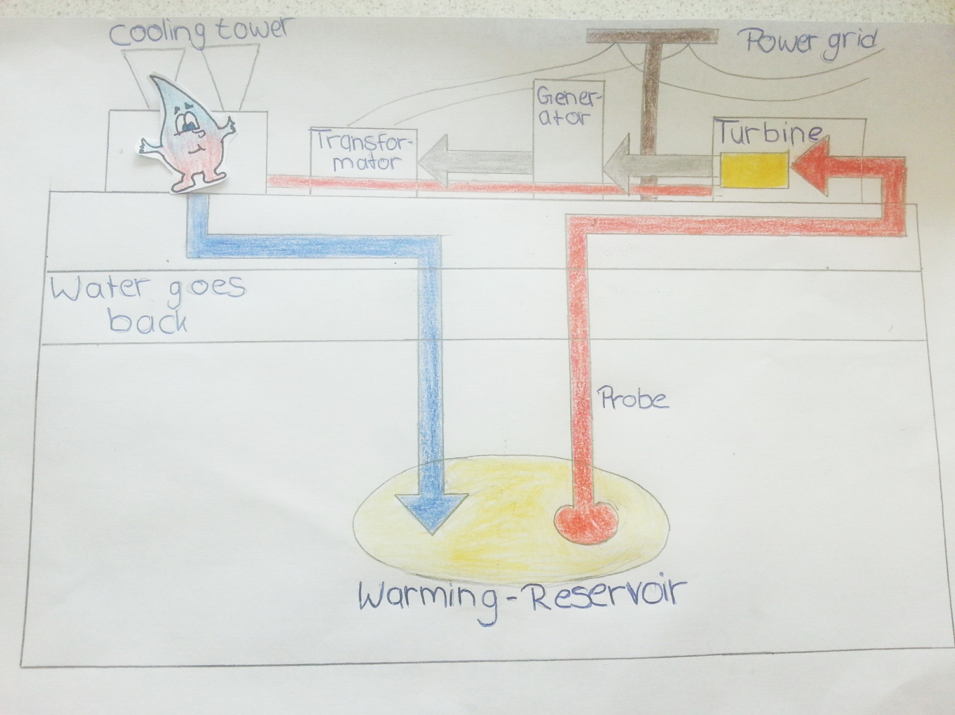
I am going into the cooling tower to be cold again

Slide 11
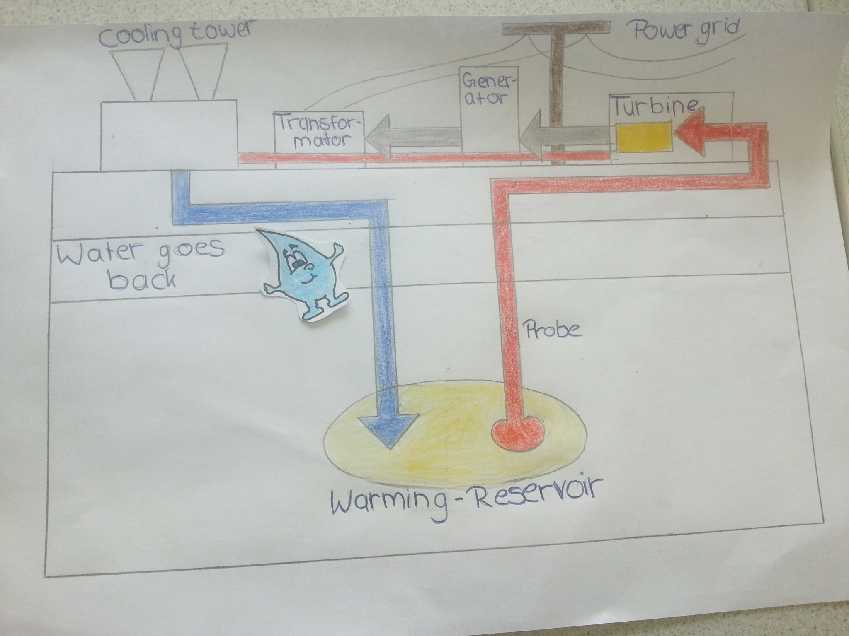
I´m going back to the warming-Reservoir

Slide 12

There are two types of ways to‚produce‘ geothermal energy.
In countries with many vulcans one does not need to drill deep into the earth because there the water will heat up fast. At vulcan areas the earth is warmer.
In non-vulcan areas one needs to drill deeper because the water does not heat up fast. The earth is colder here.

Slide 13
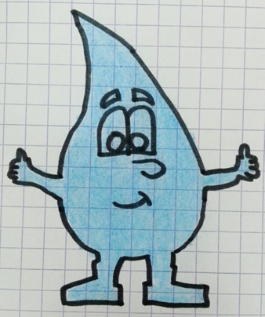
Advantages:
Does not depend on the weather
Could supply the whole world with electricity
Less CO2 ejection than fossil energy
Disadvantages:
There are radioactive particles inside the water
Responsible for earthquakes
Very expensive

Slide 14
Thanks for listening to me.
Remember you only have one chance to save the world!

Slide 15
Sources: (will follow)
Created by:
Roberto, Melina, Lara, Simay, Rebecca, Maria, Patricia, Lukas

