Slide 1

We explain to you our Erasmus experience!

Slide 2
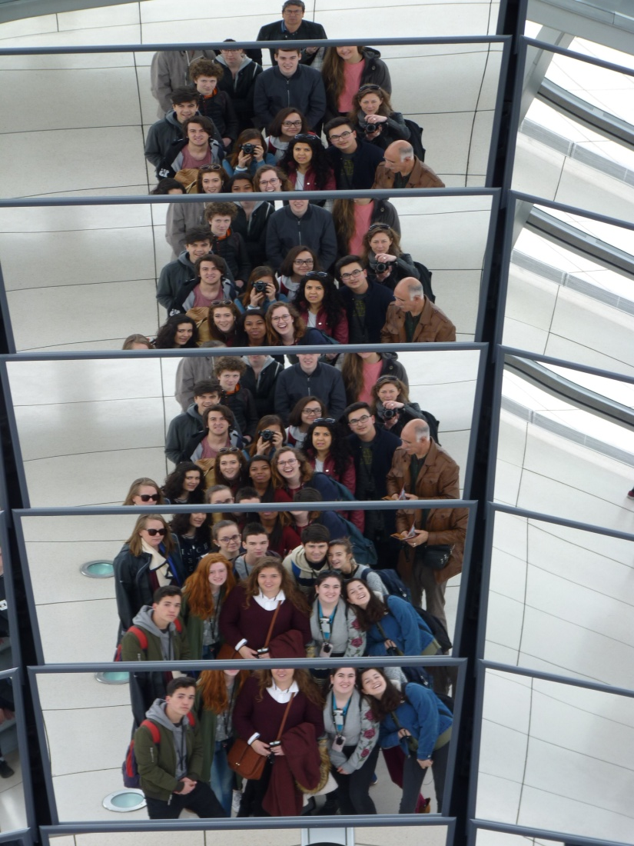
SUMMARY
1) Why is it important?
2) How does it affect to us?
- Personal
- Communication and use of the language
3) Cultural differences
4) What do we think about the project?
5) Problems we had.

Slide 3
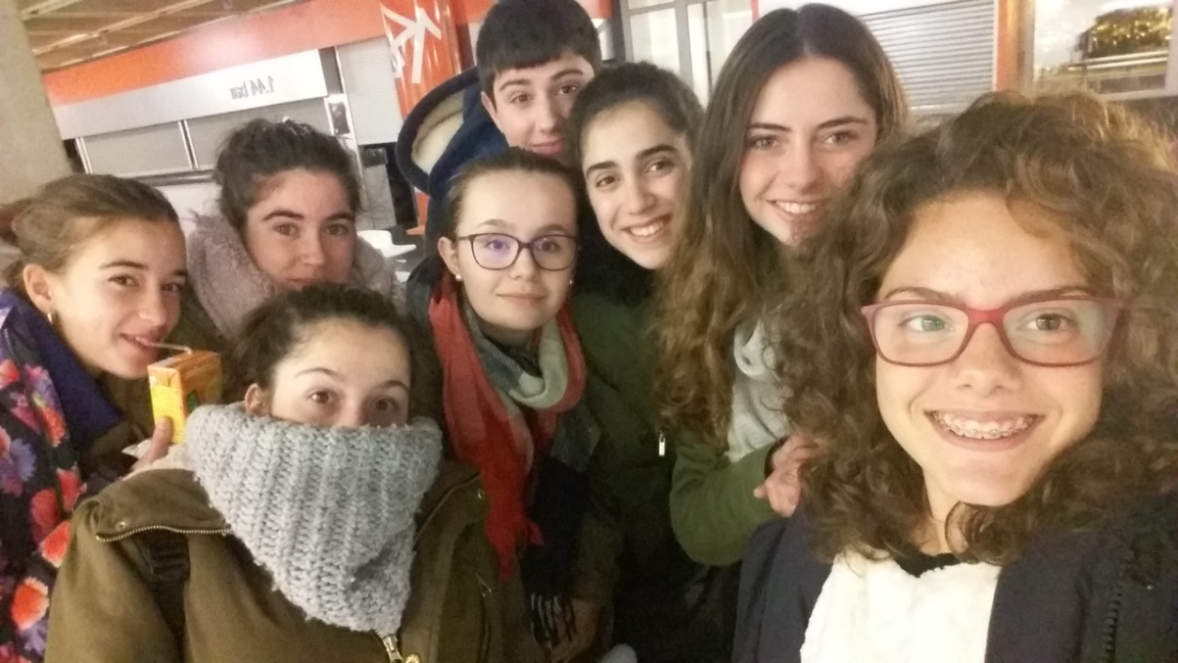
Why is it important?
It is important because it helps students to:
- Travel to other countries, communicate and learn about differents cultures.
-Learn with more interactive activities about topics like renewable energies.

Slide 4
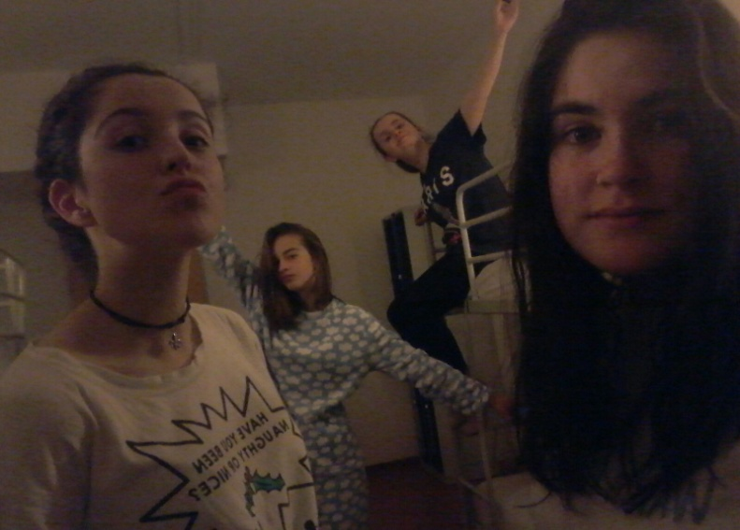
How does it affect to us?
Personal:
  You can become a more self-confident person.
  You can have more curiosity to learn.
  You can adapt better to news activities and situations.
  You can get more capacity to solve problems.
  In general, it can helps you for your future life.

Slide 5
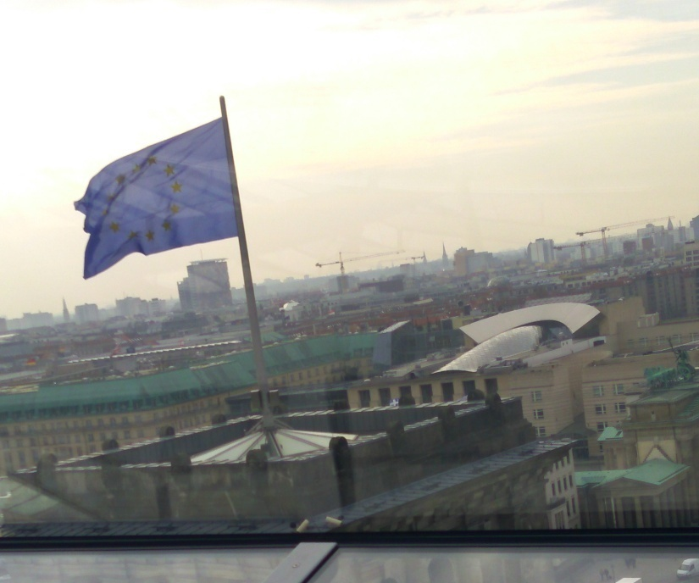
How does it affect to us?
Communication and use of the language
  You interact and work with people who come from other countries and improve your knowledge of different languages.
  You can have an idea what a foreign student can be.
  You apply languages that you learn at school.

Slide 6




Cultural differences
LUNCH AND DINNER TIME
-Spain 14h30 / 21h30
-France 12h30 / 20h
-Turkey 12h30 / 19h
-Germany 12h30 / 20h

Slide 7
LETTERS THAT ARE SPECIFIC IN THESE LANGUAGES
SPAIN ñ
TURKEY ç ğ ı ö ş ü
FRANCE ç
GERMAN The German uses these diacritical letters (Ä / ä, Ö / ö, Ü / ü) with Umlaut and a ligature (ß) (called szett (sz) or scharfes S, s long), but are not considered independent letters within alphabet.

Slide 8
Our experience as students
One of the important things of this programme is that we live with people from other countries, so we teach and learn words in our language.
English | Spanish | French | Turkish | German
Hello | Hola | Salut | Merhaba | Hallo
Bye | Adios | Au revoir | Hoşçakal | Tschüss
Let’s go | Vamos | On y va | Hadi gidelim | Los geht’s
Good morning | Buenos dÍas | Bonjour | Günaydin | Guten Morgen
How are you? | ¿Qué tal? | Ça va? | Nasilsin | Wie geht es dir?
I love you | Te quiero | Je t’aime | Seni Seviyorum | Ich liebe dich

Slide 9
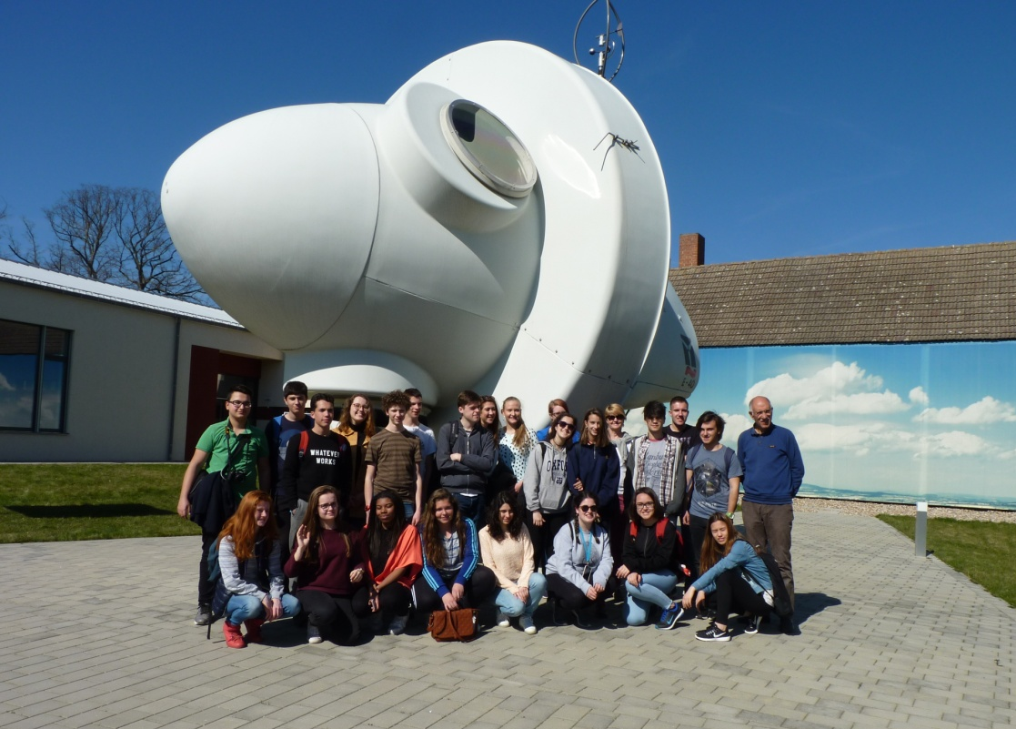
Our experience as students
We have learnt lots of things as:
-Living in other countries.
-Respect to other countries.
-The importance of renewable energy.

Slide 10
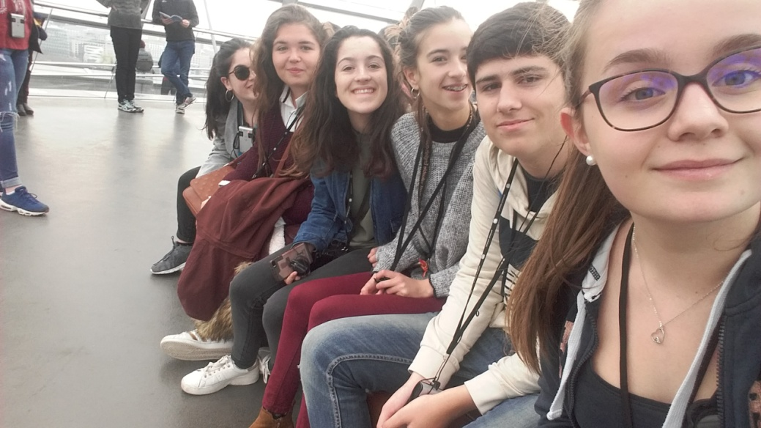
Our experience as students
If we had to choose the best thing we would say something like:
-The best thing for me is that I have made lots of friends.
-For me, it was that I could visit new places and new cultures.
-As a teacher, I like seeing my students grow as a person.
-I learnt a lot about renewable energies.

Slide 11
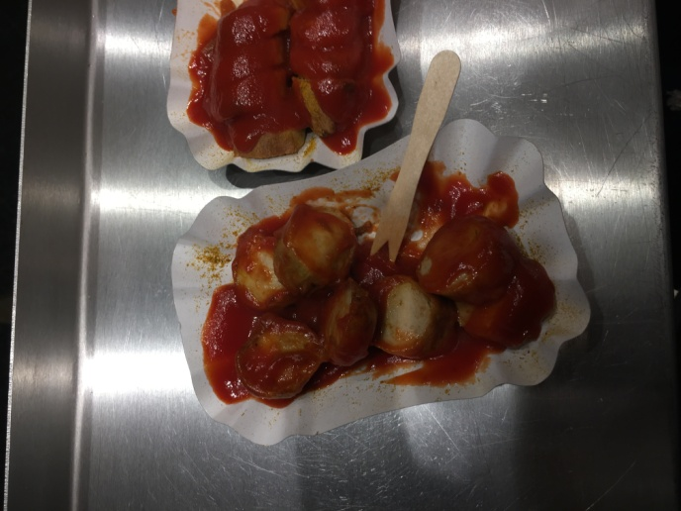
Our experience as students
And about the worst things, it is difficult to answer, but if we have to say something:
-The topic might be boring if it is not worked in a good way.
-I would have liked to do more cultural activities.
-Personally, the worst thing was the food, please change that!

Slide 12
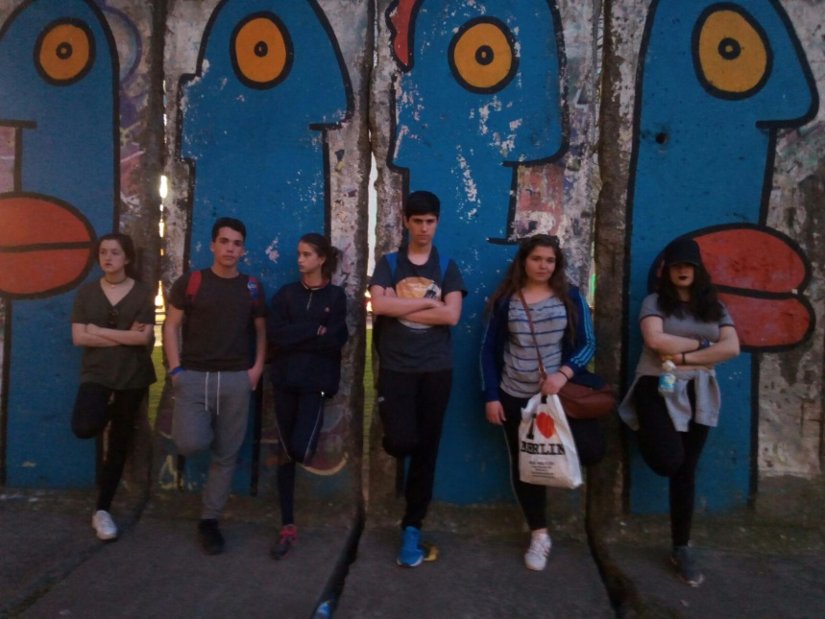
SPANISH TRADITIONS
Kiss on cheek no hug
Not in time, always few minutes later.
More touchy and extroverty.(emotional people)
Start the day later
Small breakfast
Working up to the evening.

Slide 13
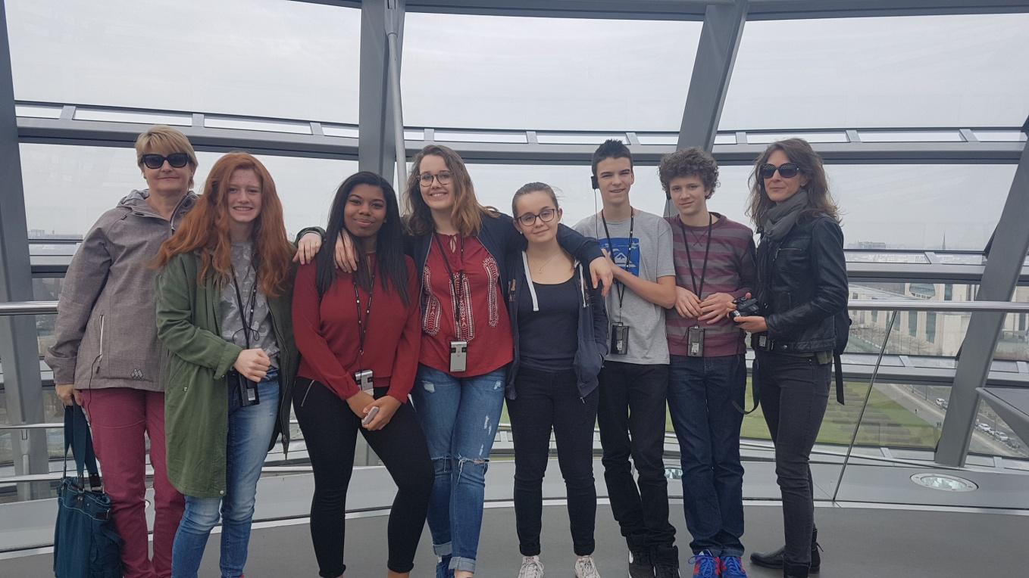
FRENCH TRADITIONS
Country of enjoyment.
Excellent food.
Kiss on the cheek instead of a hug.
French kiss

Slide 14
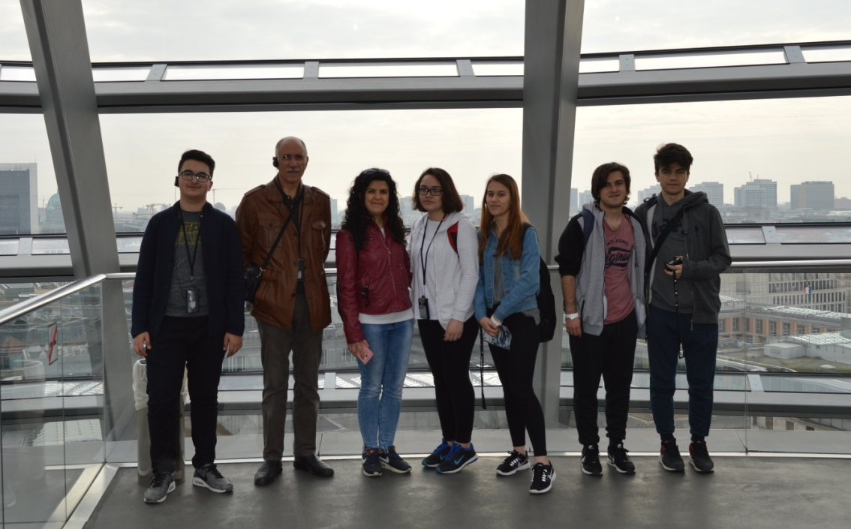
TURKISH TRADITION
Hospitable community
Superstitious people
Some women wear a head scarf

Slide 15
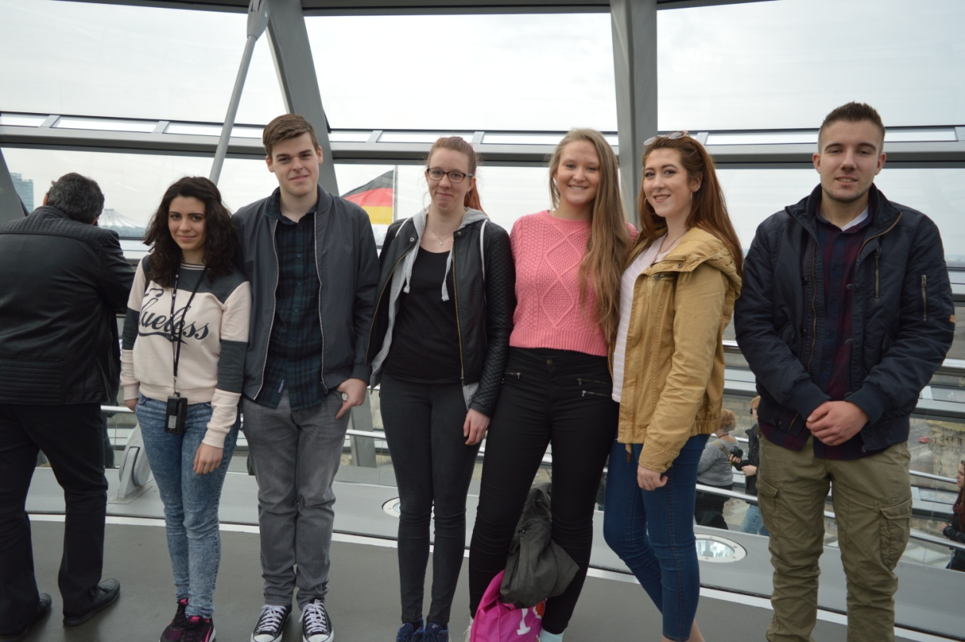
GERMAN TRADITION
In time
Cruel history
They usually like soccer

Slide 16
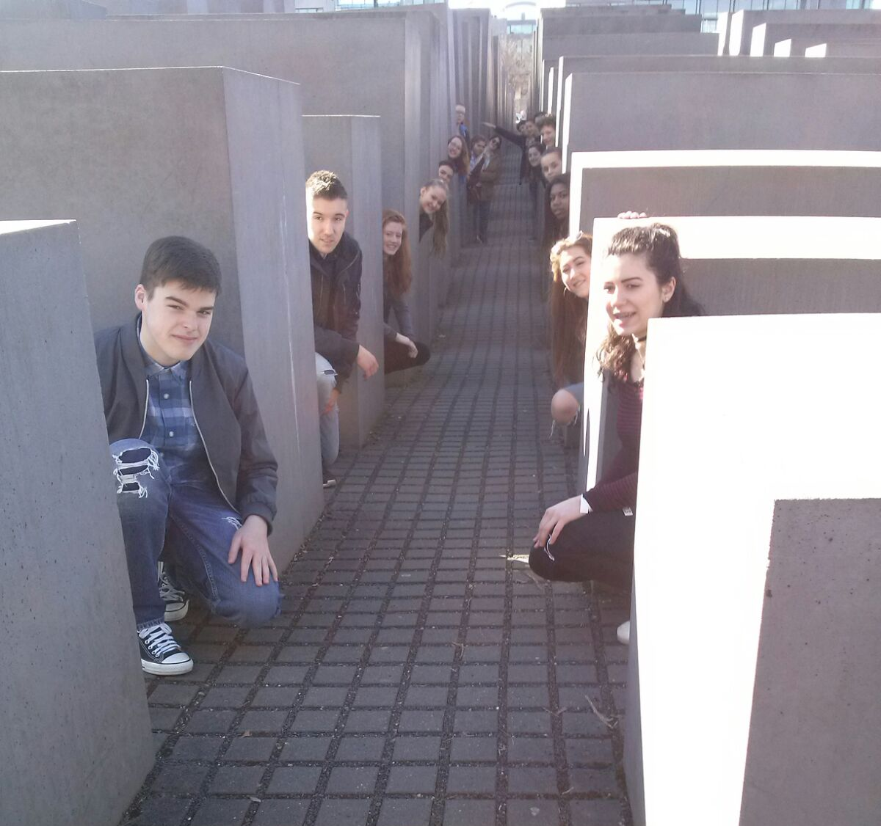
Gossipping
M**** fell in love with C********!
E**** the sheep is a looser because he cried and said : ’’ It’s so spicy !!! ‘’.
S***** has been a caterpillar!
A***** tried to twerk on a wall.
J****** fell down because she wanted to see a very beautiful boy !

Slide 17
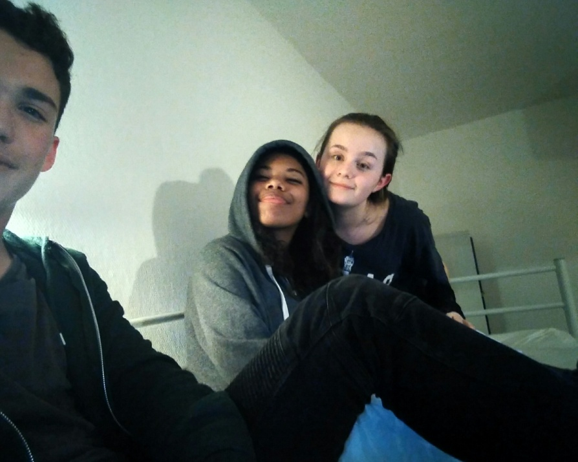
Gossipping
A****** and A***** did a dance battle and A***** and J****** won.
A****** fell down on the stairs.
E**** do the chicken dance and A***** the rain dance.
E**** slept in M****’s bedroom on the floor.
Turkish and German did a party.
T*** and C***** are the new couple of this trip! Congratulation!!

Slide 18


