Slide 1
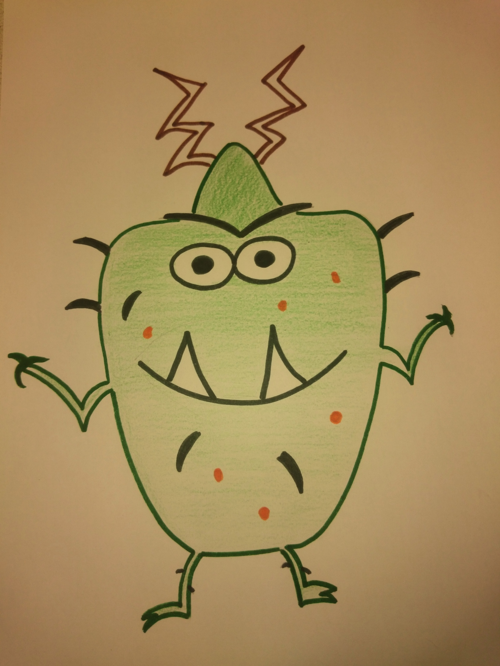
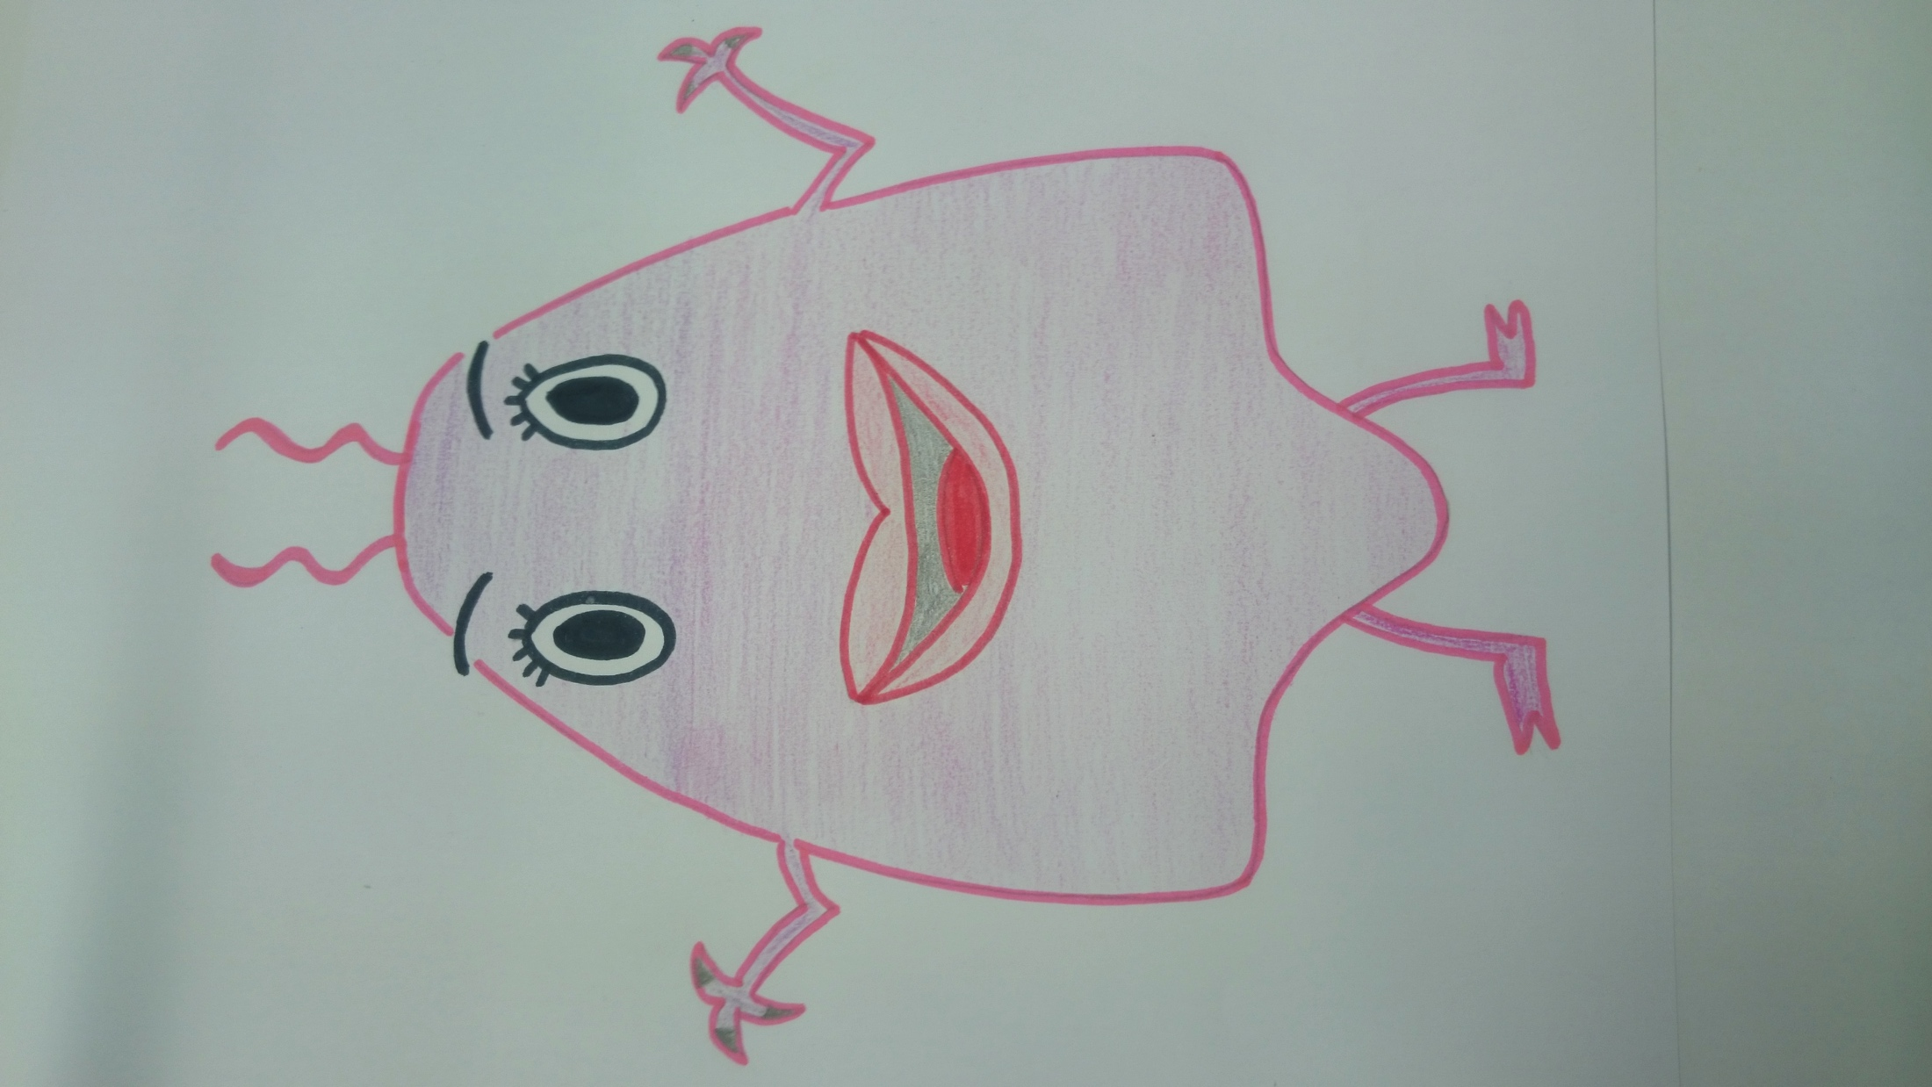
Biogas
Mr. and Mrs. Bacteria

Slide 2
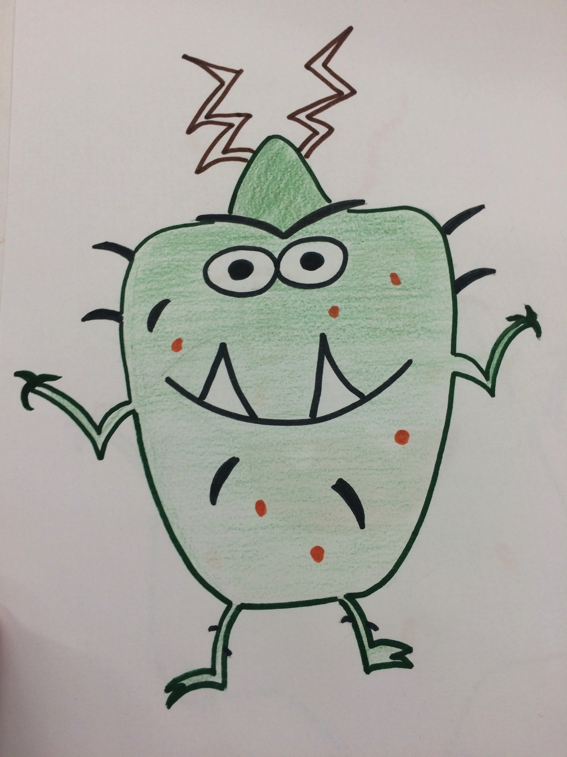
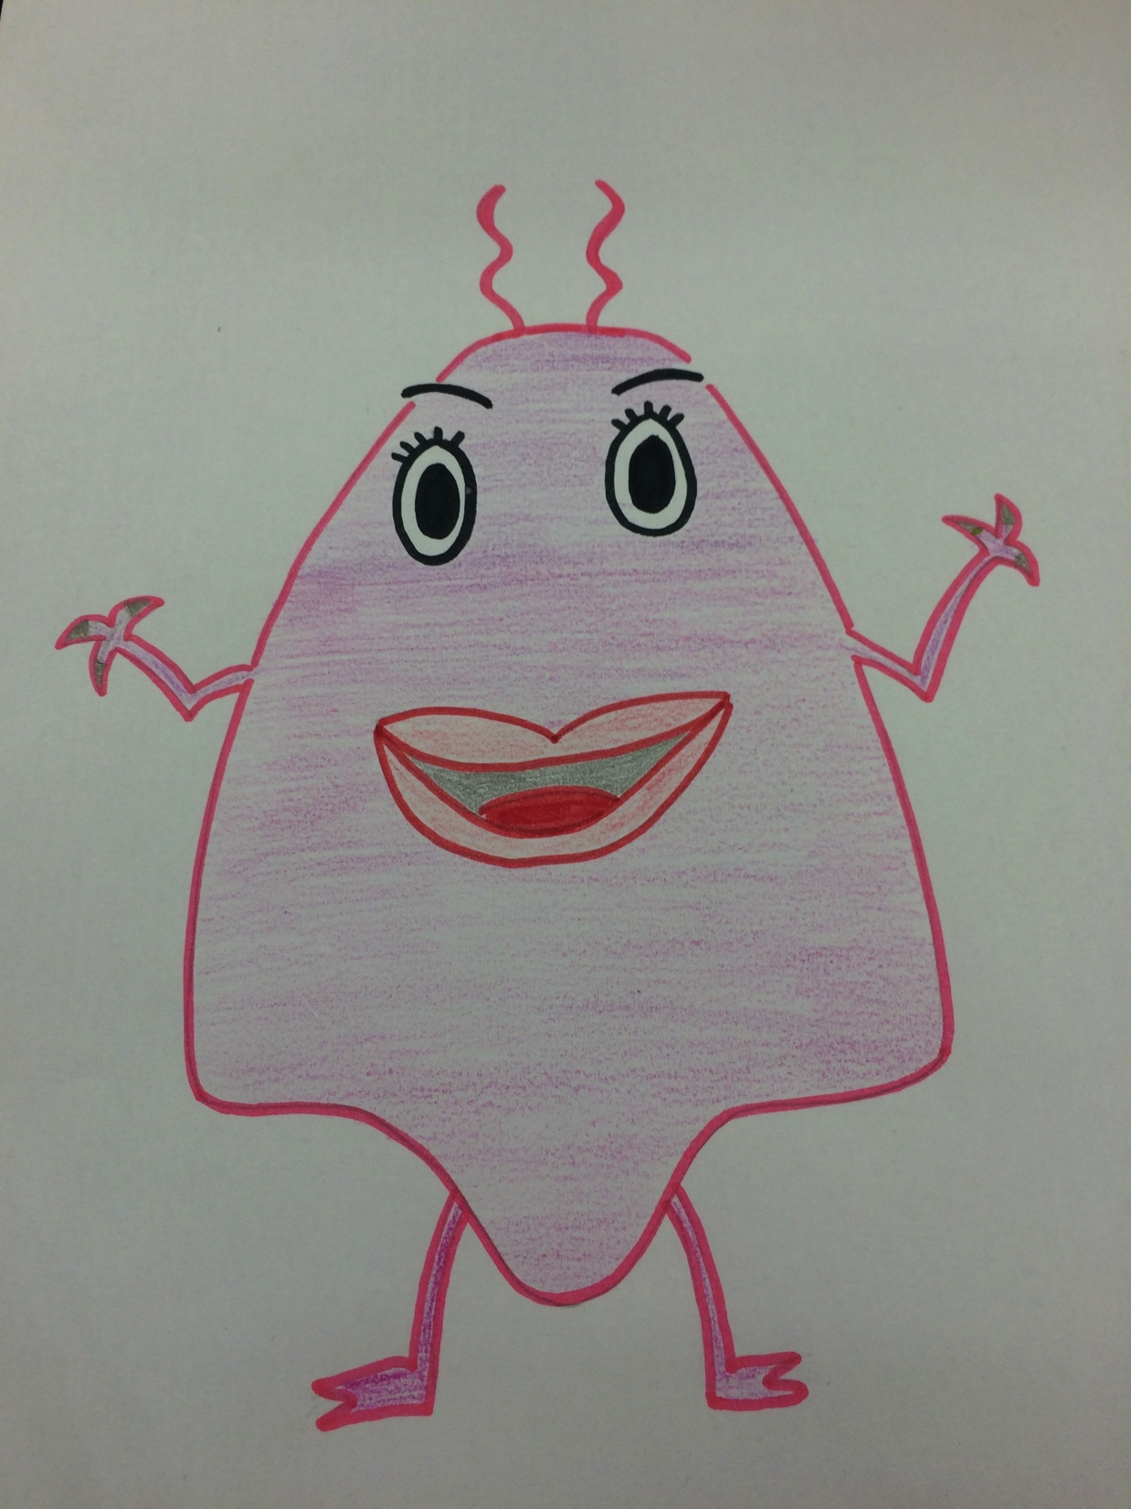
Do you know something about biogas?
No! What is biogas?
So I‘m gonna explain it to you.

Slide 3
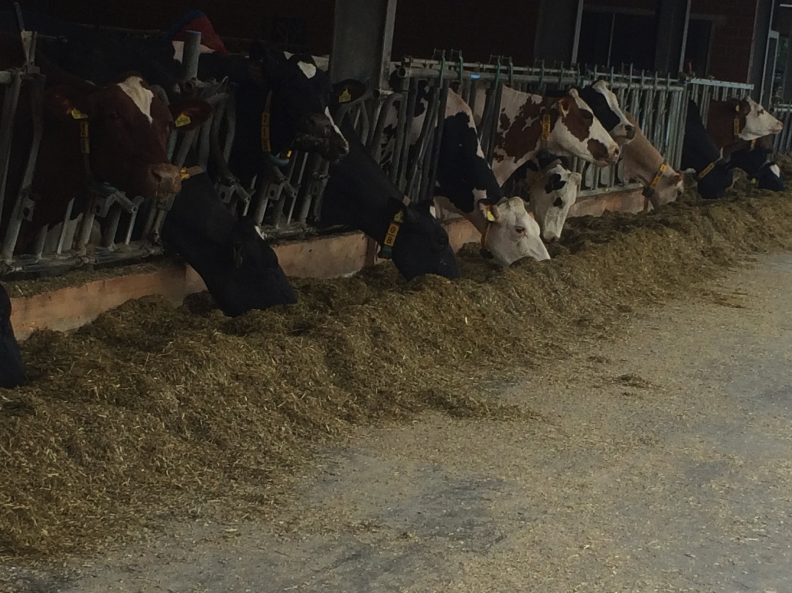
These are our friends the cows...
They produce biogas.

Slide 4
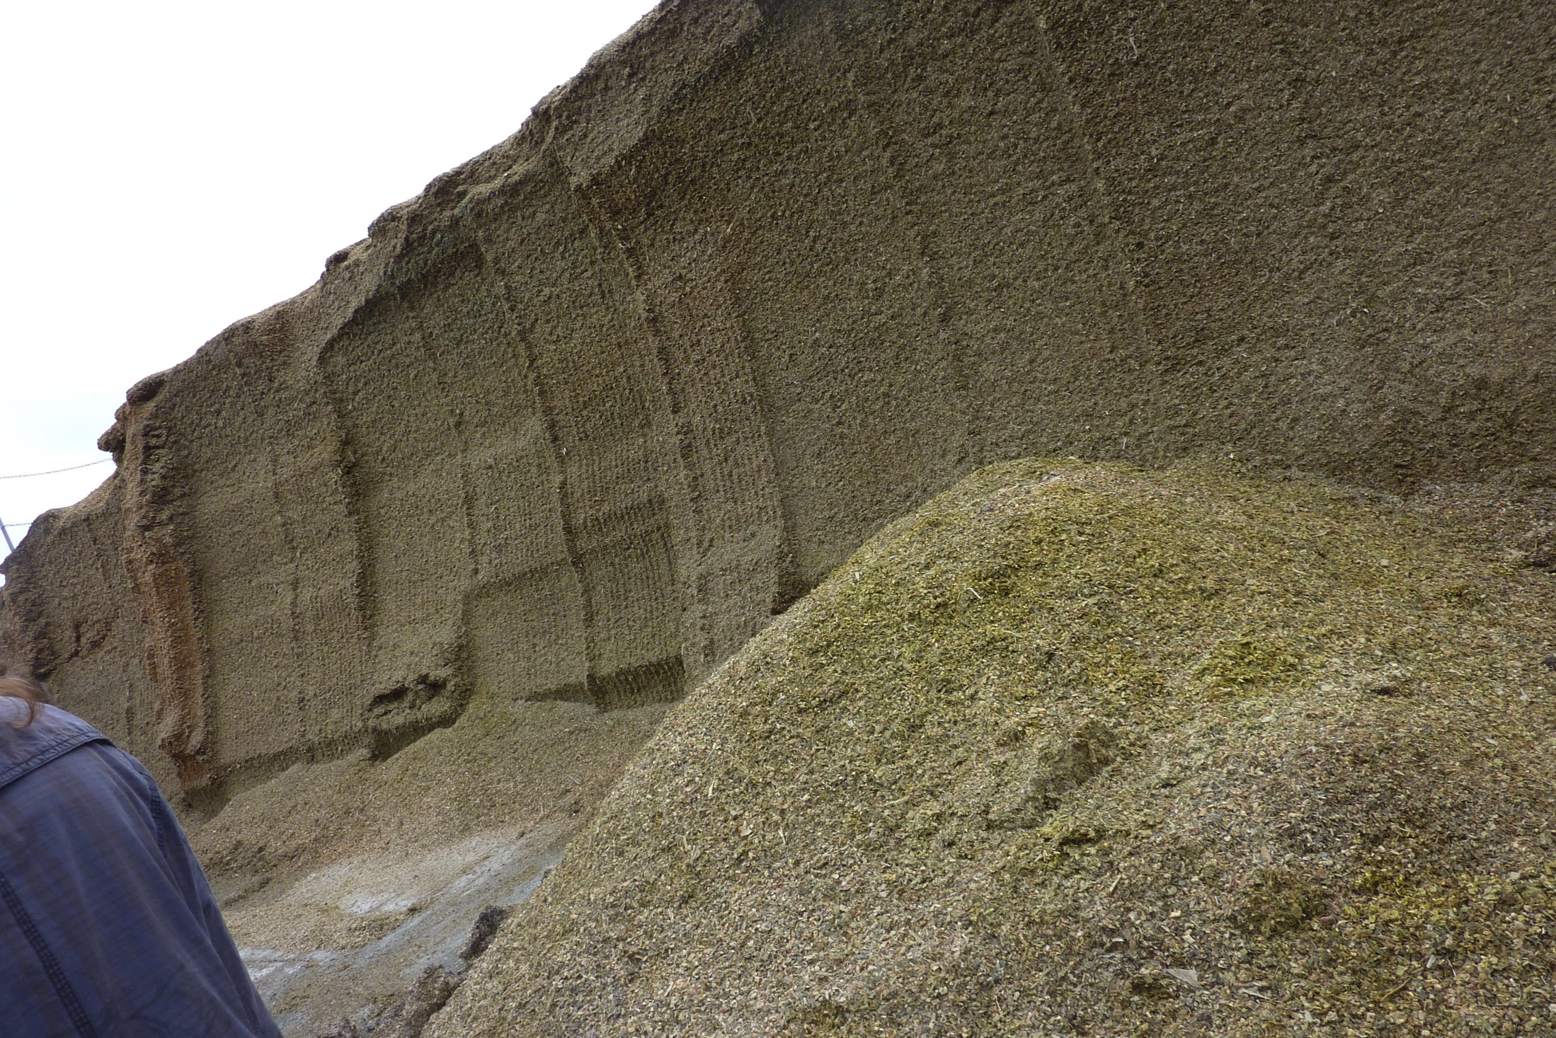
This is mais silage.
Biogas is also produced out of this.

Slide 5
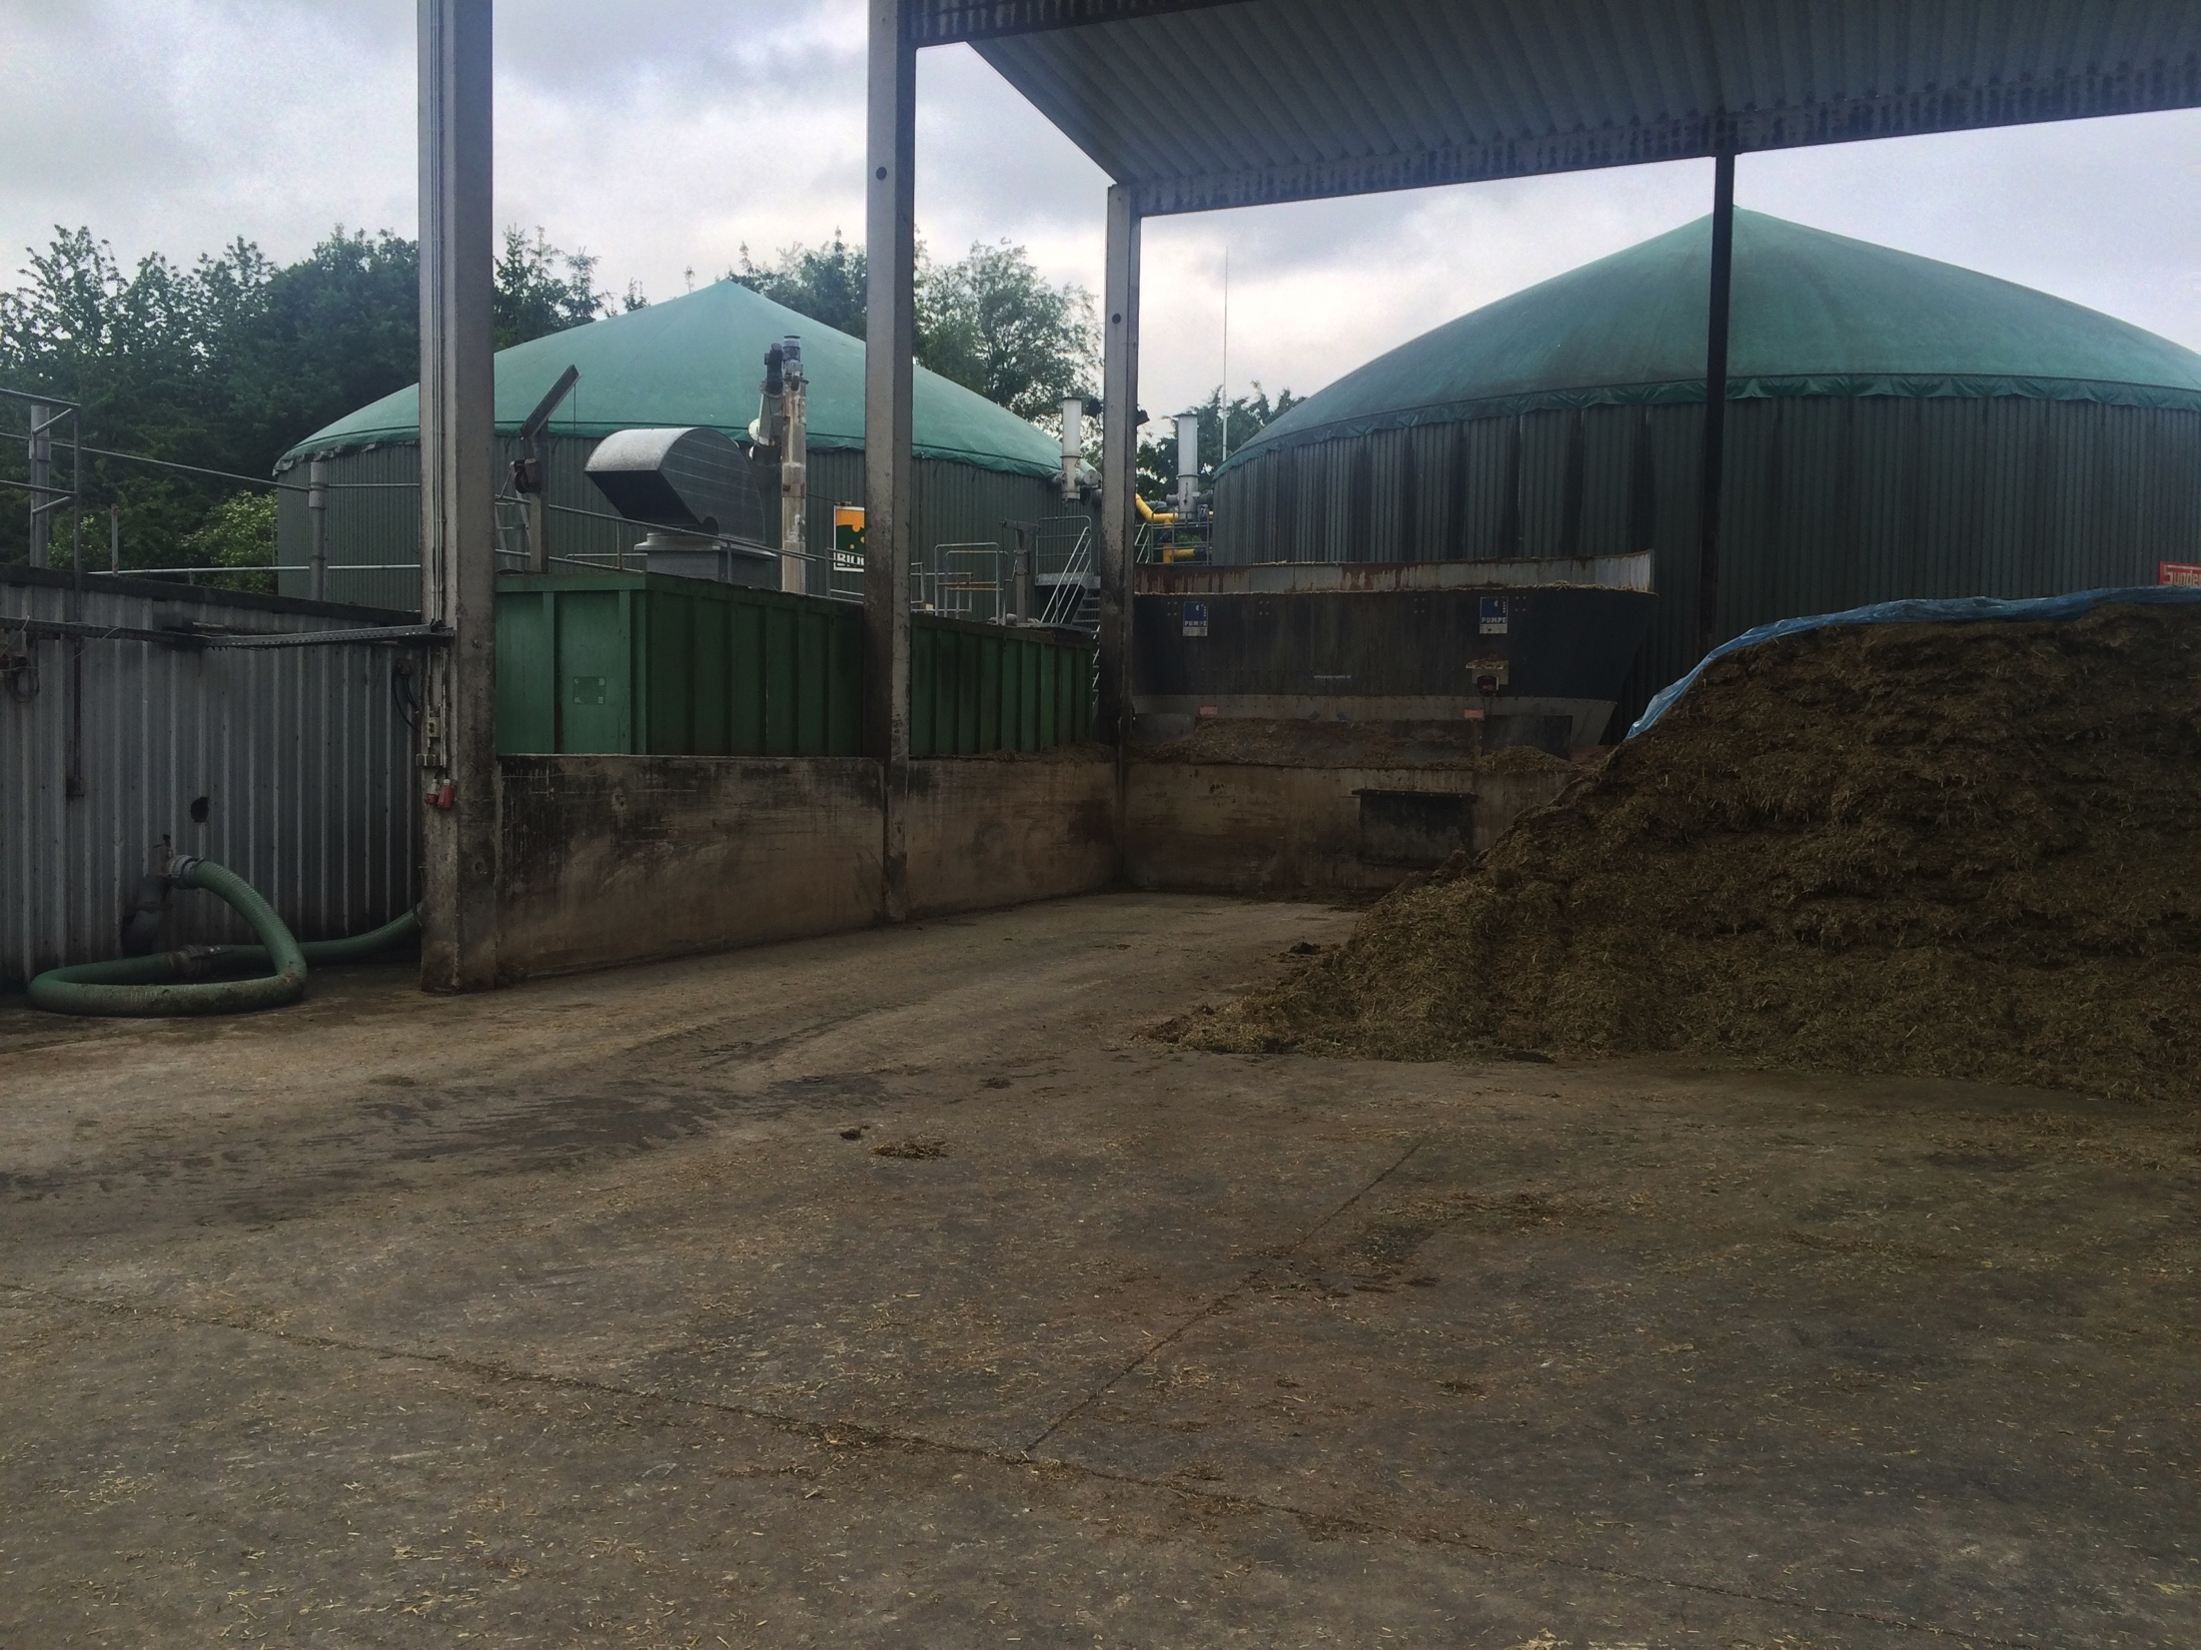
This is a biogas plant.

Slide 6
the slurry or manure goes into a digester with gas storage
in this there‘s a heating system for us bacteria
we eat the stuff
we produce the biogas out of it
after that biogas goes into a gas engine and a generator or into a gas conditioning
you can get electricity or biomethan
the dirt goes to the fields

Slide 7
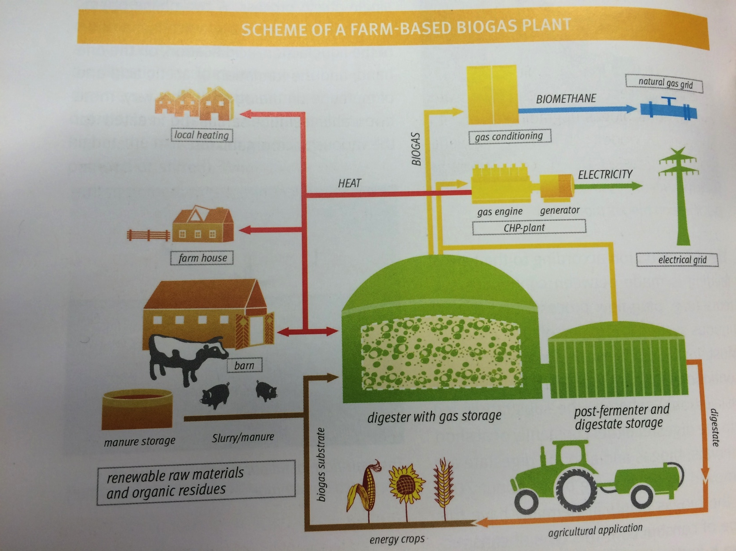
Here you can see it in a picture.

Slide 8
Ok. That‘s it. Do you understand all?
Yes. You explain it very good! Thank you.

Slide 9
Bye
Bye Bye

Slide 10




Erasmus +
made by Denise, Gala, Canem, Pauline, Henriette, Burak & Nils

